Slide 1
DevOps for Beginners

Slide 2
Topic of this Course 1-http/https,Nginx 2-Docker 3-Git/Gitlab CI 4-Bash scripting 6-Ansible 7-Prometheus/Grafana/Loki 8-redis 9-Kubernetes begin

Slide 3

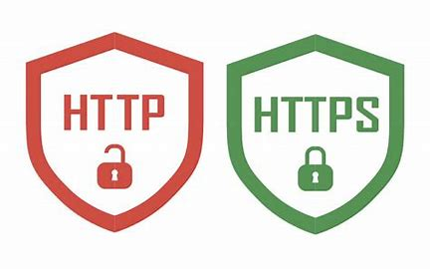
HTTP/HTTPS
HTTP, or Hypertext Transfer Protocol, is the foundation of data communication on the World Wide Web. It is an application-layer protocol used for transmitting hypermedia documents, such as HTML, between clients
HTML: How could help to HTTP
1.Formating Data
2.Linking between files
3.Font Style

Slide 4
HTTP/HTTPS
How HTTP Works
Client-Server Model:
A client (e.g., a web browser) sends an HTTP request to a server.
The server processes the request and sends back an HTTP response.
Stateless Protocol:
HTTP is stateless, meaning each request is independent and unrelated to previous requests. Sessions or state management (e.g., cookies) are handled at the application level.

Slide 5
HTTP/HTTPS
Request Methods:
Common HTTP methods include:
GET: Retrieve data from the server(Fetching a user's profile).
POST: Send data to the server for processing(for example login,create user).payload boy of request
PUT: Store specified data or update existing data on the sepecified location on server(upload image).
DELETE: Remove data from the server(delete user account).
PATCH: Partially update data on the server(Changing a user's email address)
HEAD: request the title of the request
OPTION:Retreive the HTTP request s that the server support

Slide 6
HTTP/HTTPS
Response Server:
1xx: Informational message
2xx: Success
3xx:Redirection
4xx: Client Error
5xx: Server Error
100 Continue: The server has received the request headers, and the client should proceed to send the request body.
101 Switching Protocols: The server is switching protocols as requested by the client (e.g., upgrading to WebSocket). (http→ ws , https-> wss) (web socket for realtime )
102 Processing: The server is processing the request but has not yet completed it.

Slide 7
HTTP/HTTPS
Response Server:
200 OK: The request was successful, and the response contains the requested data.
201 Created: The request was successful, and a new resource was created (upload complete).
202 Accepted: The request was accepted for processing, but the processing is not yet complete.
204 No Content: The request was successful, but there is no content to send in the response body.
301 Moved Permanently: The requested resource has been permanently moved to a new URL.
302 Found: The requested resource has been temporarily moved to a different URL.(SEO ,redirect for maintenance site)
304 Not Modified: The resource has not been modified since the last request (used for caching).
307 Temporary Redirect: The request should be repeated with another URI, but the method should not be changed.
308 Permanent Redirect: The request should be repeated with another URI, and the method should not be changed (permanent).

Slide 8
HTTP/HTTPS
Response Server:
400 Bad Request: The server cannot process the request due to a client error (e.g., malformed syntax).
401 Unauthorized: Authentication is required or has failed.
403 Forbidden: The client does not have permission to access the resource.
404 Not Found: The requested resource could not be found on the server.
405 Method Not Allowed: The HTTP method used is not supported for this resource.
408 Request Timeout: The server timed out waiting for the request.
409 Conflict: The request conflicts with the current state of the server (e.g., duplicate data).
410 Gone: The requested resource is no longer available and will not be available again.
415 Unsupported Media Type: The request entity has a media type that the server does not support.
429 Too Many Requests: The user has sent too many requests in a given amount of time (rate limiting).

Slide 9
HTTP/HTTPS
HTTPS Hardening
HSTS: Enable HTTP Strict Transport Security
HSTS forces browsers to use HTTPS for all communication with the server, preventing downgrade attacks.
Strict-Transport-Security: max-age=31536000; includeSubDomains; preload
Certificate Transparency (CT)
Certificate Transparency is a framework that logs all issued SSL/TLS certificates in publicly auditable logs. This helps detect misissued or fraudulent certificates.
Modern browsers require Certificate Transparency for all publicly trusted certificates
Expect-CT: enforce, max-age=86400, report-uri="https://example.com/report"

Slide 10
HTTP/HTTPS
Versions of HTTP
HTTP/1.0: Basic version with limited features.
HTTP/1.1: Improved performance with persistent connections and chunked transfer encoding.
HTTP/2: Introduced multiplexing, header compression, and server push for faster performance.
HTTP/3: Uses QUIC (a transport protocol over UDP) for reduced latency and improved reliability.

Slide 11
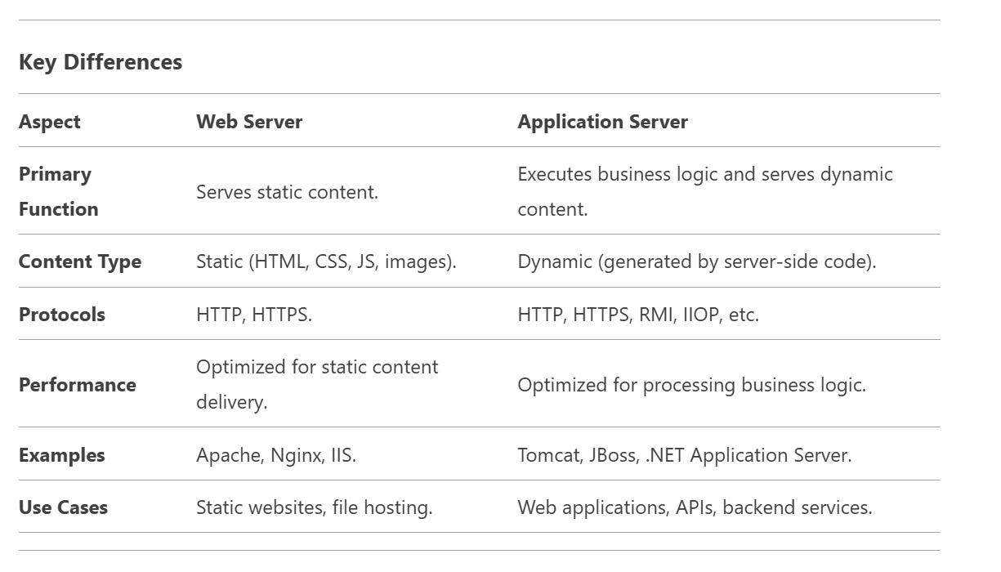
APPLICATION SERVER VS WEB SERVER

Slide 12
Nginx
Nginx as reverse proxy
A reverse proxy is a server sits between client and backend server forwarding client request to the appropriate backend and returning the server’s response to the client.
proxy_pass backend;
proxy_set_header Host $host;
proxy_set_header X-Real-IP $remote_addr;
proxy_set_header X-Forwarded-For $proxy_add_x_forwarded_for;
Set proxybuffer for slow client buffer of for when nginx server low memory
proxy-bind when have more network interface

Slide 13
Nginx
Nginx as Load Balancer
it means using the Nginx web server to distribute incoming network traffic (HTTP/HTTPS requests) across multiple backend servers. This improves performance, reliability, and scalability of web applications.
upstream backend_servers {
# Define backend servers (can be IPs or domain names)
server 192.168.1.10:80; # Backend Server 1
server 192.168.1.11:80; # Backend Server 2
server 192.168.1.12:80; # Backend Server 3
}
server {
listen 80;
server_name example.com;
location / {
proxy_pass http://backend_servers; # Forward requests to the backend group
proxy_set_header Host $host;
proxy_set_header X-Real-IP $remote_addr;
}
}
}

Slide 14
Nginx
Nginx as Load Balancer
Notice: nginx open source in "passive mode" for load balancing (LB), it means that nginx does not actively check backend server health but instead relies on request failures to determine if a server is down.it doesn’t have health check
LB methodes:
1-Round Robin: (By default) Distributes requests equally across servers
2-Least Connection: Sends requests to the server with the fewest active connections
3-IP Hash: Same client IP always goes to the same server (for session persistence) statefull app

Slide 15
Nginx
Nginx CertBot for let’s encrypt
apt install certbot python3-certbot-nginx
Self Sign
openssl req -x509 -newkey rsa:4096 -sha256 -days 365 -nodes \
-keyout /etc/ssl/private/server.key -out /etc/ssl/certs/server.crt \
-subj "/CN=your-domain.com" \
-addext "subjectAltName=DNS:your-domain.com,DNS:*.your-domain.com,IP:127.0.0.1"

Slide 16

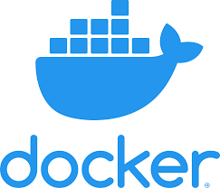
Docker
Docker is an open platform for developing, shipping, and running applications. Docker enables you to separate your applications from your infrastructure so you can deliver software quickly.
Baremetal vs Vm and efficiency docker in bare 5X .

Slide 17
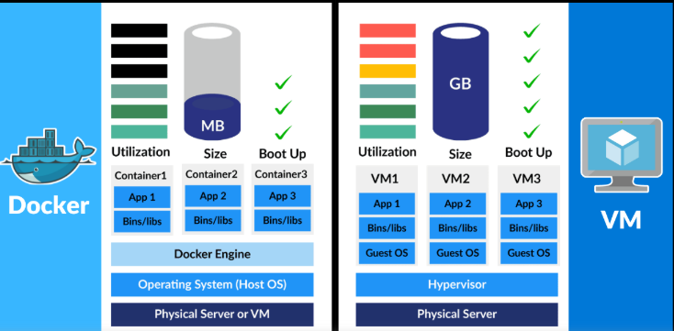
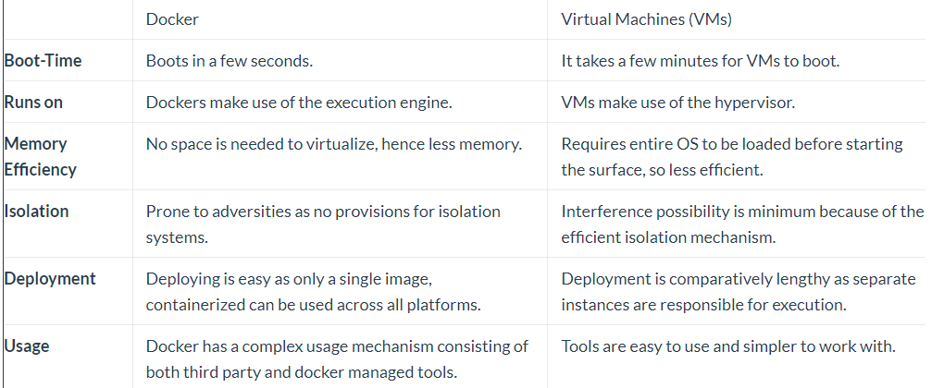
vm vs container

Slide 18

what is image?
A Docker image is a collection of all the files that make up and executable software app.
This collection includes the all the lib,bin,modules and dependency just need to run the app everywhere.
Image is read only

Slide 19
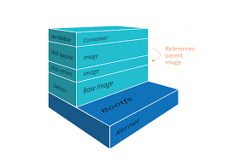
Image architechure
Layer :
1-Layers consist of parent child relation just first layer 2-don’t have parent said base image
3-Docker image use shared kernel of docker host
4-Layers are Reusable and Shared
5-Rebuilding the image will be faster

Slide 20

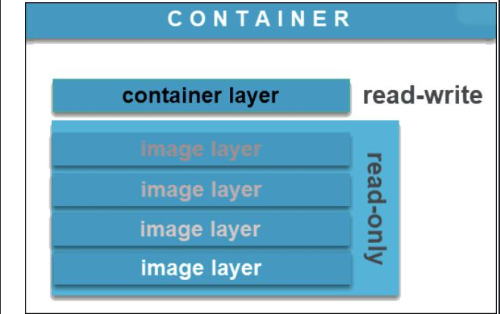
what is container
A Docker container image is a lightweight, standalone, executable package of software that includes everything needed to run an application: code, runtime, system tools, system libraries and settings
Container is writable.
Image vs container

Slide 21

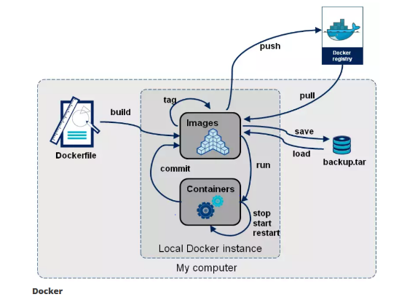
Docker Registry
A Docker Registry is a play that docker images store in it.
Docker Registry consist of public or private
Public DockerHub
Private Harbor or Nexus repo

Slide 22
Installation docker
on linux https://docs.docker.com/engine/install/
on windows
https://docs.docker.com/desktop/install/windows-install/

Slide 23
Docker Concept
docker version:
Show client version
Show client apiversion
Show server version
Show server api version
Docker written by golang
/var/lib/docker all of docker elements in there
docker info:This command displays system wide information regarding the Docker installation. Information displayed includes the kernel version, number of containers and images. The number of images shown is the number of unique images. The same image tagged under different names is counted only once.

Slide 24
manage docker
The Docker daemon binds to a unix socket instead of a tcp port.by default unix socket is owned by root .docker daemon always runs as the root user!
Docker Daemon: A persistent background process that manages
Docker images, containers, networks, and storage volumes.
Non root use below manual
groupadd docker
usermod –aG docker $USER

Slide 25

some Benefit of Docker container
1-Speed
2-Portability
3-Rapid Deployment
4-Run your app in isolation and independent env

Slide 26

solve some problem by container
1-Dependencies
2-Protecting your pc
3-Easy deploy without huge knowledge about program language
4-Security and virus jail

Slide 27

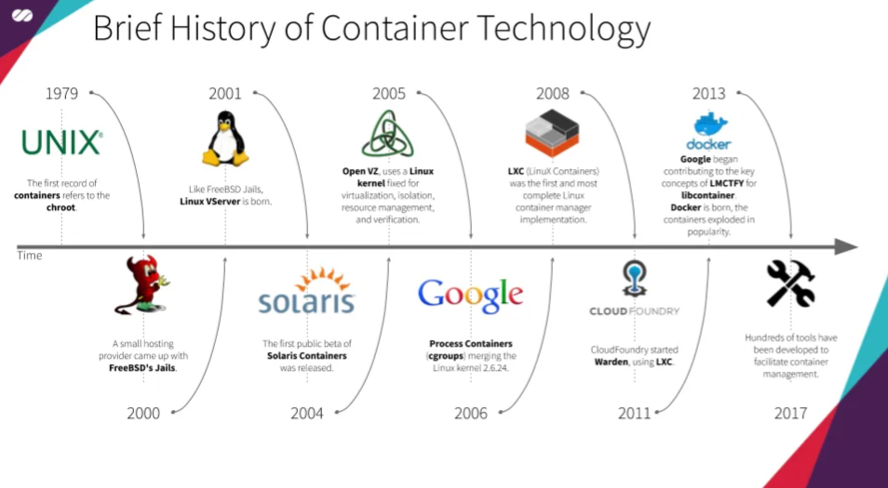
History of Container

Slide 28
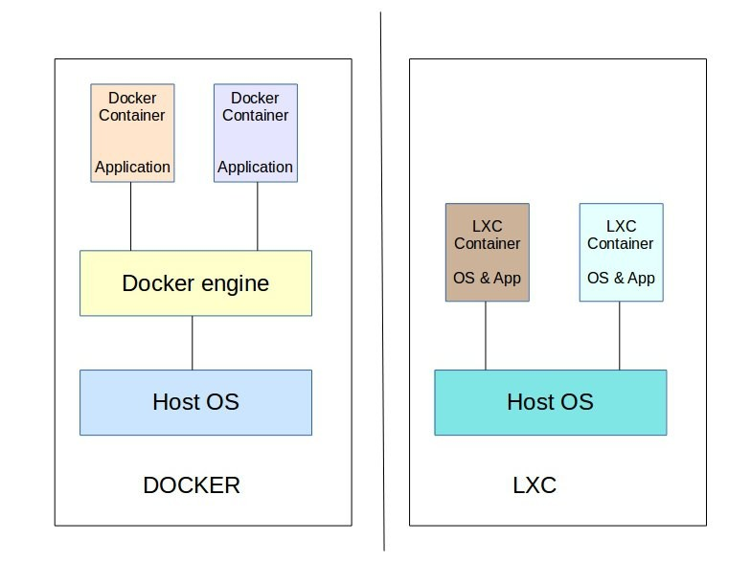
LXC vs Docker

Slide 29
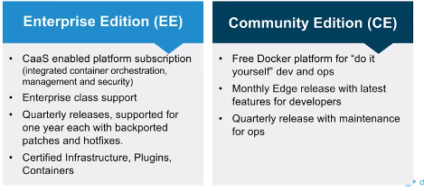
Docker company history
Docker ce
Docker inc
Docker ee(free private repo , free tool for scan image)

Slide 30
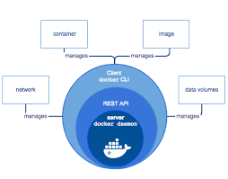
Docker Engine
The Docker engine is the core software that runs and manages containers which follows client-server architecture
Docker engine components:Server,RestAPI,CLI
Server(docker daemon)=(dockerd)
Rest API(control docker daemon what to do)
Cli (docker client)

Slide 31
LXC
In old version docker ,exist lxc (for linux) communicate with kernel
Docker can not work with cg and ns and lxc communicate with them
If docker request to lxc we cannot docker in windows and mac ….
If lxc update ,docker should be update that communicate with docker
Docker create libcontainer

Slide 32
Docker engine architecture
Docker client
Docker client with api call docker server.
Docker daemon pass to cn to manage container lifecylce
Run create container
Shim keep stout stdin and report the container’s exit status code
Docker daemon(server)
containerd
runc
runc
runc

Slide 33
cgroups and ns
Cgroups: (abbreviated from control groups) is a Linux kernel feature that limits, accounts for, and isolates the resource usage (CPU, memory, disk I/O, etc.) of a collection of processes , limitation
Namespace: provide a layer of isolation. Docker uses namespaces of various kinds to provide the isolation that containers need in order to remain portable and refrain from affecting the remainder of the host system view (pid,net,mnt,ufs)

Slide 34
Daemonless containers
Enable live restore
vi /etc/docker/daemon.json
live-restore:true
When docker daemon crash or stop ,yet container working this feature just in linux ☺))

Slide 35
Docker storage
Storage driver(graphdriver) manage read write on disk host
Type of storage 1-aufs 2-overlay 3-devicemapper 4-brtfs 5-Zfs
Change storage driver in daemon.json
Change docker storage is very sensitive
1-docker save 2-push to priv storage 3-change in daemon 4-daemon restart 5-pull image locally 6-restart containers

Slide 36
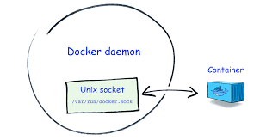
docker.sock
docker.sock is the UNIX socket that Docker daemon is listening to. It's the main entry point for Docker API. It also can be TCP socket but by default for security reasons Docker defaults to use UNIX socket.

Slide 37
dangle image
When image and tag show none:none
docker image prune remove dangle image
Create image with name and same tag and don’t error

Slide 38
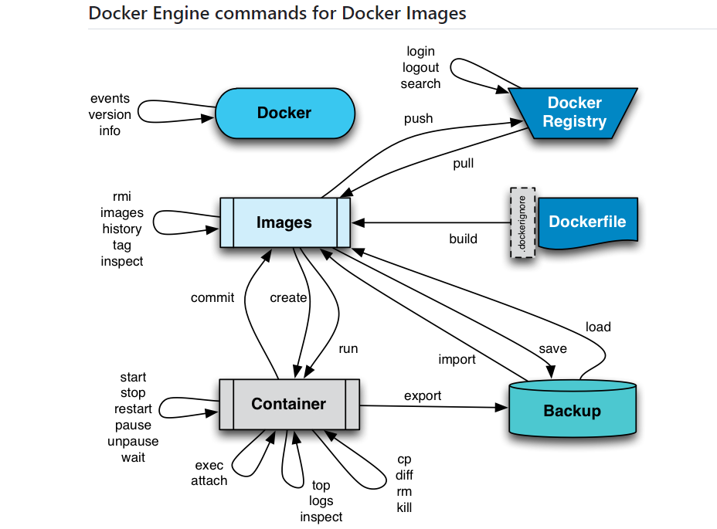
docker diagram

Slide 39
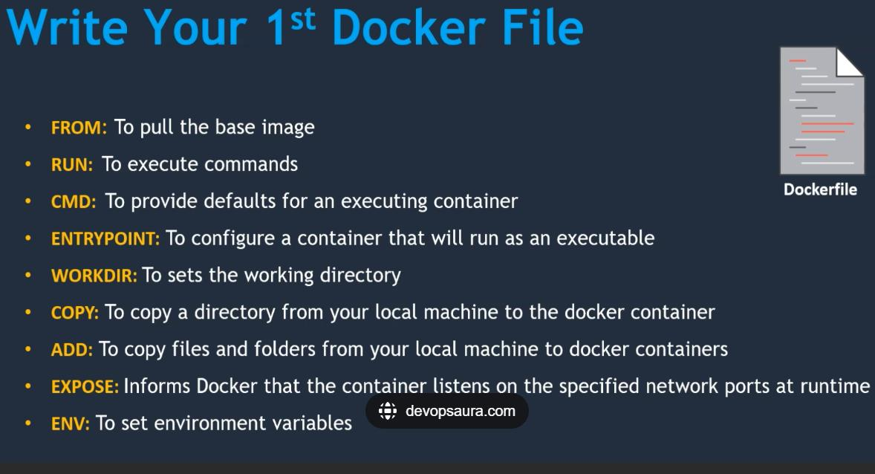
dockerfile
Dockerfile is a text file that contains a set of instructions used to build a Docker image. It automates the process of creating a containerized environment by defining exactly what should be included in the image

Slide 40
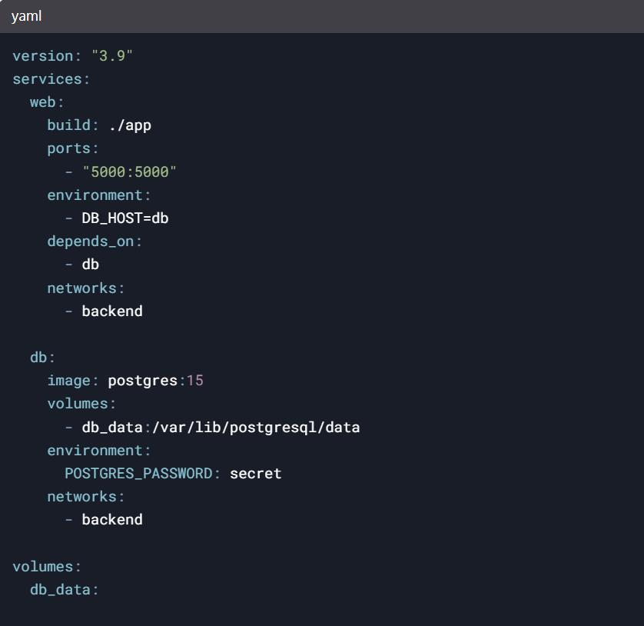
docker-compose
Docker Compose is a tool for defining and running multi-container Docker applications. Instead of manually starting each container and linking them together, you use a YAML file (docker-compose.yml) to configure all your services, networks, volumes, and dependencies in one place

Slide 41
docker-compose
Why Use Docker Compose?
Simplified Orchestration: Manage multi-container apps with one file.
Reproducibility: Share the same environment across teams.
Dependency Management: Auto-start linked services (e.g., databases

Slide 42
Docker restart policy
Docker's restart policies determine whether a container should automatically restart after exiting. These policies help maintain application availability
no (Default)
Behavior: The container will not restart automatically under any circumstances. Use Case: For containers that should run only once or be manually managed.
on-failure[:max-retries]
Behavior: Restarts the container only if it exits with a non-zero status (i.e., failure).Use Case: Ensuring failed services recover automatically, with controlled retries
Always
Behavior: Restarts the container unconditionally, even after:Manual stops (e.g., docker stop) or Docker daemon restarts (e.g., system reboot).
Note: If manually stopped, it will restart when the Docker daemon restarts,Use Case: Critical services that must always run (e.g., web servers).
unless-stopped
Behavior: Similar to always, except: If the container is manually stopped (e.g., docker stop), it will not restart even after the Docker daemon restarts.
Use Case: Services that should persist unless explicitly stopped by an admin.

Slide 43
docker-swarm
Docker Swarm is Docker's native container orchestration tool designed to manage and scale containers across multiple machines. It clusters Docker hosts into a single virtual system, enabling automated deployment, scaling, and maintenance of containerized applications
Core Components
Nodes: Machines in the cluster, categorized as:
Manager Nodes: Handle cluster management, task scheduling, and state maintenance.
Worker Nodes: Execute tasks (containers) assigned by managers.
Services: Define the desired state of an application (e.g., container image, replicas, ports) and ensure Docker maintains .
Tasks: Individual container instances managed by Swarm to fulfill service requirements

Slide 44
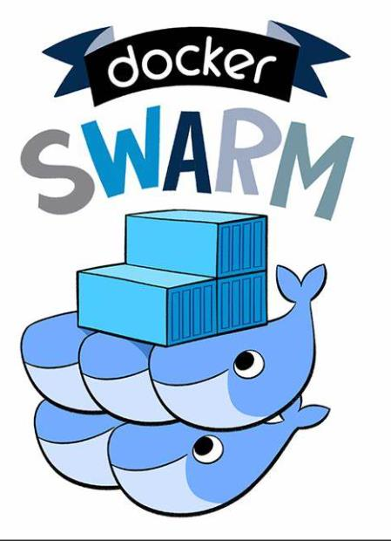
docker-swarm
Benefits
Simplicity: Integrates directly with Docker CLI and API, making it easy for Docker users to adopt.
Resource Efficiency: Lightweight architecture suits small-to-medium projects.
High Availability: Ensures applications remain operational during node failures
docker service create --name web --replicas 2 -p 80:80 docker.arvancloud.ir/nginx:latest

Slide 45
docker-swarm
Port Protocol Description
2377 TCP Swarm Management: Communication between manager nodes
7946 TCP/UDP Inter-node Communication: Service discovery and coordination (Gossip Protocol).
4789 UDP Overlay Network Traffic: For cross-node container networking
Service Discovery in Docker Swarm refers to the mechanism that allows services (containers) within a Swarm cluster to automatically find and communicate with each other without needing to know their exact IP addresses or physical locations. It is a critical feature for dynamic, distributed environments where containers may scale up/down or move between nodes.

Slide 46
docker-ai
curl -fsSL https://ollama.com/install.sh | sh
ollama run codellama

Slide 47
Vault Hashicorp
Vault (by HashiCorp) is a tool for securely storing, accessing, and managing secrets and sensitive data. At its core, Vault provides:
Sealing in HashiCorp Vault refers to the act of zeroing out Vault’s master key from memory, immediately rendering all stored data inaccessible until the master key is restored (“unsealed”). Vault always starts in a sealed state and must be unsealed before it can serve any requests
docker run -d --cap-add=IPC_LOCK --name vault3 -e 'VAULT_LOCAL_CONFIG={"storage": {"file": {"path": "/vault/file"}}, "listener": [{"tcp": { "address": "0.0.0.0:8200", "tls_disable": true}}], "default_lease_ttl": "168h", "max_lease_ttl": "720h", "ui": true}' -p 8200:8200 docker.arvancloud.ir/hashicorp/vault server

Slide 48
docker-secret
Create a secret file or pass the content directly: just for docker swarm
echo "my-secret-password" | docker secret create db_password –
docker secret ls , rm name
version: '3.8'
services:
web:
image: nginx
secrets:
- db_password
deploy:
replicas: 1
configs:
- source: nginx_conf
target: /etc/nginx/nginx.conf
secrets:
db_password:
external: true

Slide 49
docker-secret
echo "supersecret" > ./db_password.txt
docker run -v $(pwd)/db_password.txt:/run/secrets/db_password:ro my-image

Slide 50
Git
Git is a distributed version control system (VCS) used for tracking changes in code, collaborating with teams, and managing software development projects efficiently. It helps developers keep track of modifications, revert to previous versions, and work on different features simultaneously without conflicts.
Why Use Git?
✅ Efficient Code Management – Keeps track of all changes made by developers. ✅ Collaboration Friendly – Enables multiple developers to work on a project without conflicts. ✅ Undo Mistakes Easily – Rollback to previous versions if needed. ✅ Widely Used – Almost every major software development team uses Git.

Slide 51
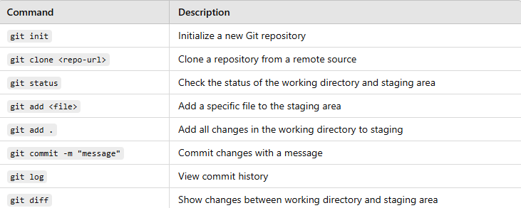
Git Commands

Slide 52
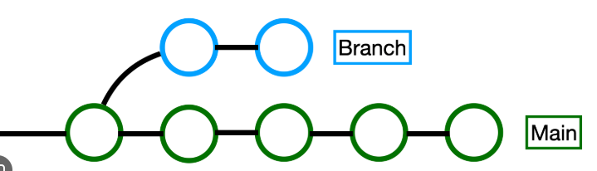
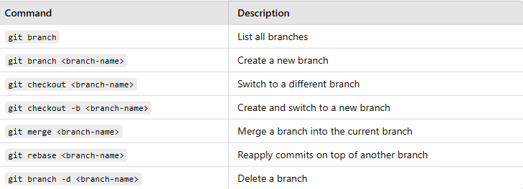
Git Branch and Merging

Slide 53
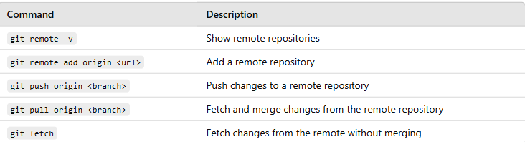
Git Remote

Slide 54
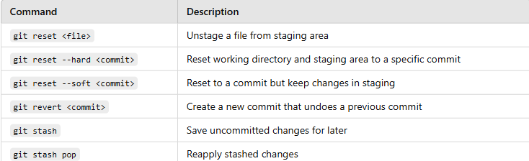
Git Undo & Fix Mistakes

Slide 55
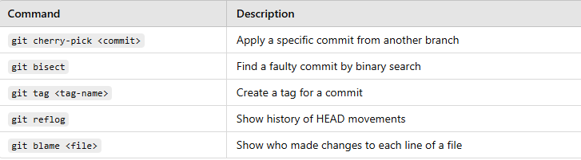
Git Advance

Slide 56
.gitignore
What .gitignore Applies To:The .gitignore file is used by Git to specify which files and directories should be ignored and not tracked by Git in a repository. When you add patterns to the .gitignore file, they tell Git to exclude certain files or directories from being committed, preventing them from appearing in the version history or repository.

Slide 57

GitLab
GitLab is a web-based DevOps platform that provides Git repository management, CI/CD pipelines, security features, and collaboration tools for software development. It is an alternative to GitHub and Bitbucket but includes built-in DevOps tools to manage the entire software development lifecycle.
https://about.gitlab.com/

Slide 58
GitLab Architecture
GitLab consists of three main layers:
Frontend (UI & API Layer)
Backend Services
Storage & Databases
1️⃣ Frontend (UI & API Layer)
GitLab Web UI – The user interface to interact with repositories, CI/CD, merge requests, etc.
REST & GraphQL API – Enables integrations with external tools like Jira, Kubernetes, and Terraform.
NGINX/Apache – Acts as a reverse proxy for managing incoming traffic and security.
2️⃣ Backend Services (Core GitLab Functionality)
Gitaly – Git server that handles Git repository operations like cloning, pushing, and merging.
Sidekiq – Background job processing system that manages asynchronous tasks (e.g., pipeline execution).
GitLab Runner – Executes CI/CD pipelines for testing and deployment.
Puma (Ruby on Rails) – The main application server that handles web requests and API calls.
Workhorse – A smart reverse proxy for handling uploads, downloads, and authentication.
ActionCable – WebSocket-based real-time communication for notifications and live updates.
3️⃣ Storage & Databases
PostgreSQL – Stores metadata like users, projects, issues, and CI/CD pipelines.
Redis – Used as a cache for faster performance and background job processing.
Object Storage (S3, MinIO, GCS, Local FS) – Stores large artifacts like Docker images, CI/CD logs, and user uploads.

Slide 59
GitLab role
Role | Permissions
Guest | View project, create issues, leave comments, access project wiki, and download artifacts.
Reporter | Everything a Guest can do + view code, see job logs, and access analytics.
Developer | Everything a Reporter can do + push to non-protected branches, create merge requests, run/trigger pipelines.
Maintainer | Everything a Developer can do + manage project settings, add/remove users, manage CI/CD, push to protected branches.
Owner | Only available at the group level. Full control over the group and all its projects, including transferring projects and deleting them.

Slide 60
GitLab Architecture
What is a Protected Branch in GitLab?
A protected branch restricts what users can do with it. Typically used for critical branches like main, master, or production, it helps ensure:Only certain users can push.Only authorized users can merge changes.Optional: Pipelines must pass before merges are allowed.Optional: Code reviews and approvals are enforced.

Slide 61
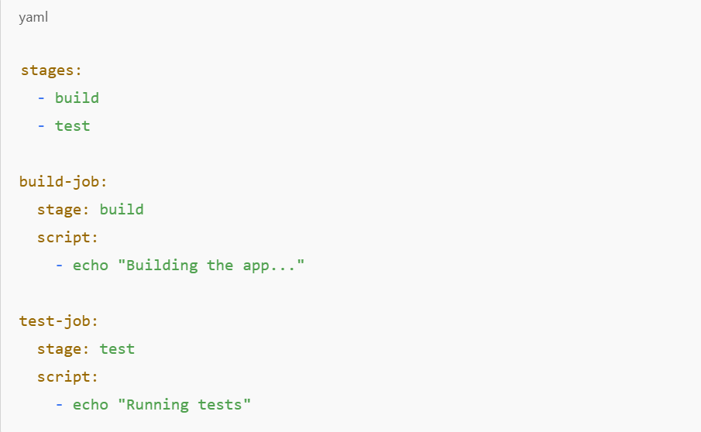
gitlab-ci
🛠️ What is gitlab-ci?
gitlab-ci stands for GitLab Continuous Integration — it's the built-in system in GitLab that automates your software workflows like building, testing, and deploying your code.It's all powered by a special file in your repo called: .gitlab-ci.yml

Slide 62
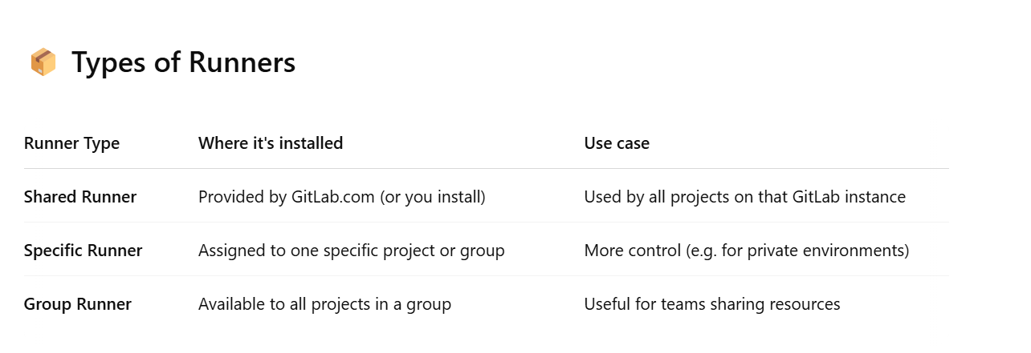
Gitlab Runner
🛠️ What is Gitlab Runner?
A GitLab Runner is a lightweight agent (a program) that runs the jobs you define in your .gitlab-ci.yml file.You can think of it as the worker that GitLab sends your jobs to. Without a runner, your CI/CD pipeline can’t actually do anything.
🧱 What is a Job in GitLab?
A job is a single task you want GitLab to perform — like running tests, building a Docker image, or deploying your app.

Slide 63
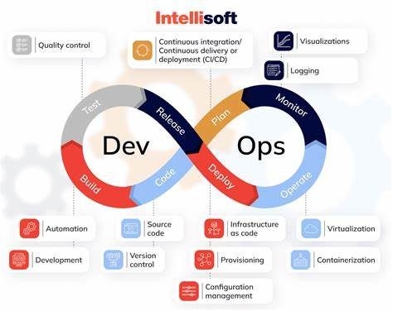
CI/CD

Slide 64
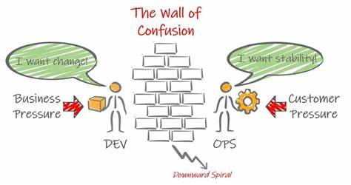
CI/CD

Slide 65
CI/CD
CI (Continuous Integration)
👉 CI is the process of automatically building and testing code whenever a developer pushes changes to a repository.
Steps in CI:
Developers commit code to a Git repository (GitHub, GitLab, Bitbucket).
Automated build and test process runs (e.g., unit tests, linting).
Feedback is given (pass/fail status, test results).
If successful, the code is merged into the main branch.
Benefits of CI:
✅ Detects bugs early. ✅ Ensures code consistency. ✅ Automates testing to prevent breaking changes.

Slide 66
CI/CD
CD (Continuous Delivery & Deployment)
Continuous Delivery
👉 CD ensures that every change is tested and ready for deployment at any time.
After passing CI, the new version is prepared for deployment but requires manual approval before going live.
Continuous Deployment
👉 Every change that passes testing is automatically deployed to production without manual intervention.
Used in highly automated environments where frequent releases are required.
Benefits of CD:
✅ Reduces time to release new features. ✅ Eliminates manual deployment errors. ✅ Ensures a stable and consistent release process.

Slide 67
Databases
What is a Database?
A database is an organized collection of data, stored and accessed
Components of MySQL:
MySQL Server.
MySQL Client (Command Line, Workbench).
Database, Tables, and Records.
Sample mysql code
CREATE TABLE students (
id INT AUTO_INCREMENT PRIMARY KEY,
name VARCHAR(100),
age INT,
grade CHAR(1)
);

Slide 68
mysql vs mariadb
Feature | MySQL | MariaDB
Ownership | Owned by Oracle | Open-source, community-driven
Compatibility | Compatible with MariaDB (mostly) | Fully compatible with MySQL
Storage Engines | InnoDB, MyISAM, NDB, Memory, CSV | InnoDB, Aria, MyISAM, TokuDB, RocksDB, etc.
Replication | Master-Slave, Group Replication | Master-Slave, Galera Cluster, Group Replication
Performance | Good for transactional workloads | Better optimizations, supports more engines
Additional Features | Limited community features | Advanced features (e.g., Virtual Columns, ColumnStore)
Partitioning | Supported | Advanced partitioning (incl. subpartitioning)
Community | Oracle-driven, limited contributions | Fully community-driven

Slide 69
Basic SQL Commands (CRUD)
CREATE: Insert data into a table: INSERT INTO students (name,age,grade) VALUES (‘javad’,’20’,’A’);
READ: Query data from a table. SELECT * FROM students;
UPDATE: Modify data. UPDATE students SET grade=20 WHERE id=1 ;
DELETE: Remove data. DELETE FROM students WHERE id=1;

Slide 70
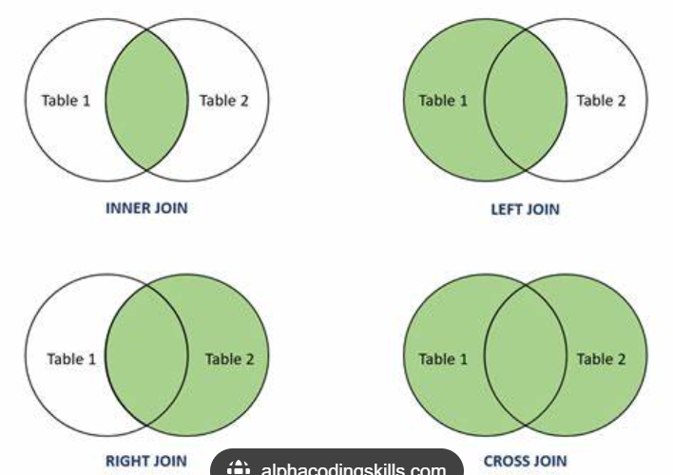
Joins and Relationships
Understanding Joins in SQLContent:
INNER JOIN: Combines rows from two tables where there is a match
.LEFT JOIN: Returns all rows from the left table, with matching rows from the right.
RIGHT JOIN: Similar to LEFT JOIN but returns rows from the right table.

Slide 71
User Management and Security
Creating Users and Granting Privileges:
CREATE USER 'username'@'localhost' IDENTIFIED BY 'password’;
GRANT ALL PRIVILEGES ON database_name.* TO 'username'@'localhost’;
Security Best Practices:
1-Use strong passwords.
2-Assign least privileges necessary for users
3-Regularly audit user permissions.

Slide 72
Database Backup and Restoration
Backup with mysqldump:
mysqldump -u root -p database_name > backup.sql
Restoring from Backup:
mysql -u root -p database_name < backup.sql
Automating Backups: Using cron jobs

Slide 73

MySQL Performance Optimization
mysqltunerDescription: A popular Perl script that helps analyze your MySQL server's performance and provides recommendations for tuning.
Features:Analyzes MySQL configuration and running status.
Provides suggestions for optimizing server variables like buffer sizes, query cache, and thread settings.
Reports on key performance metrics such as slow queries, buffer usage, and cache hits.
Built in mysql
SHOW STATUS;
SHOW VARIABLES;

Slide 74
Ansible
. Ansible is an open-source automation tool designed for IT tasks such as configuration management, application deployment, orchestration, and infrastructure provisioning. Here's a concise breakdown of its key features and functionalities:
Agentless Architecture:
Uses SSH (Linux/Unix) or WinRM (Windows) to communicate with remote systems.
Declarative Playbooks:
Configuration and workflows are defined in YAML files called playbooks.
Idempotent: Playbooks ensure systems reach the desired state, even if run multiple times (no unintended changes)
Modules:
Pre-built modules for common tasks (e.g., apt for package installation, copy for file transfer).
Over 3,000+ modules available for cloud (AWS, Azure), containers, networking, and more
Inventory:
A file (inventory.ini) listing managed hosts and groups (e.g., webservers, dbservers)

Slide 75

Ansible
Configuration Management:
Enforce consistent configurations across servers (e.g., install packages, manage users).
Example: Ensure Nginx is installed and running on all web servers.
Application Deployment:
Deploy code or applications to production environments.
Example: Push a Python app to servers, install dependencies, and restart services.
Orchestration:
Coordinate multi-tier workflows (e.g., deploy a web app, database, and load balancer in sequence).
Ansible language is python
https://docs.ansible.com/ansible/latest/index.html
Ansible server don’t install on windows

Slide 76
Ansible
Test ansible -m ping localhost
ansible python module location = /usr/lib/python3/dist-packages/ansible
Meaning: This is the directory where Ansible's core Python modules are installed.
Significance: All Ansible code (modules, plugins, core libraries) resides her
ansible collection location = /root/.ansible/collections:/usr/share/ansible/collections
Meaning: The paths where Ansible searches for collections (bundles of playbooks, roles, modules, and plugins
executable location = /usr/bin/ansible
jinja version = 3.1.2
Meaning: The version of the Jinja2 templating engine installed.
Significance: Ansible uses Jinja2 for templating (e.g., dynamic {{ variables }} in playbooks
libyaml = True
Meaning: The libyaml library is installed, which speeds up YAML parsing.
Significance: Faster playbook execution compared to the slower pure-Python YAML parser.
Ansible config file /etc/ansible/ansible.cfg

Slide 77
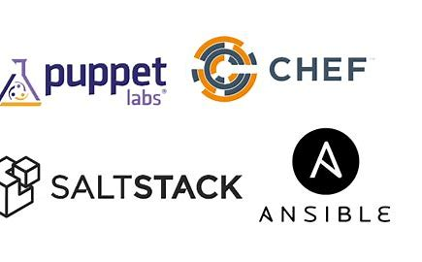
Ansible Comparison
Aspect | Ansible | SaltStack (Salt) | Puppet | Chef
Architecture | Agentless (SSH/WinRM). | Master-Minion or Agentless. | Master-Agent. | Master-Client.
Language | YAML + Jinja2. | YAML + Jinja2 or Python. | Puppet DSL (Ruby-like). | Ruby (Recipes/Cookbooks).
Agent Required? | No. | Optional (Minions). | Yes (Puppet Agent). | Yes (Chef Client).
Ease of Use | Low (YAML syntax). | Moderate (Flexible but complex). | Steep (DSL learning curve). | Steep (Ruby expertise needed).
Scalability | Small to Medium. | Large-scale, real-time. | Enterprise-scale. | Scalable but resource-intensive.
Key Strength | Simplicity, agentless, cloud-native. | Speed, event-driven automation. | Compliance, state enforcement. | Flexibility, Ruby-driven customization.
Community | Largest (Red Hat-backed). | Active (VMware-backed). | Enterprise-focused. | Mature but smaller.
Primary Use Case | Cloud provisioning, CI/CD, simple automation. | Large-scale orchestration, NetDevOps. | Enterprise IT compliance. | Complex app lifecycle management.

Slide 78
Why Ansible Need?
1000 servers config!!!!!!
Config app in new server how can?
Ansible as like as document
Reduce time wait and prevent overloaded
(hardening os,os upgrade,clustering db,performance testing,networking,user authenticate and authorize)

Slide 79
Ansible Component
/etc/ansible
hosts.yaml is a inventory file
Ansible-playbook.yaml
- name: Install and configure Nginx
hosts: webservers
become: yes
tasks:
- name: Install Nginx
apt:
name: nginx
state: present
- name: Ensure Nginx is running
service:
name: nginx
state: started
enabled: yes

Slide 80
Ansible Test
ansbile –m -I hosts.yaml all ping
ansible-playbook filename.yml
first task in playbook:
Ansible performs a "Gathering Facts" step at the beginning of every playbook run. This collects system information (like OS type, IP, memory, etc.) as variables.
Okay with green color and changed with yellow if error show with red

Slide 81
Ansible command
Run specific task
ansible-playbook file.yml --help
--started-at-task “name task”

Slide 82
Ansible variable
- name: Install and configure Apache Web Server
hosts: webservers
become: true
vars:
apache_package: httpd vars:
vars/external_var1.yaml
apache_service: httpd
index_file: /var/www/html/index.html
welcome_message: "Welcome to Iman's DevOps Class!"
tasks:
- name: Install Apache package
yum:
name: "{{ apache_package }}"
state: present
- name: Ensure Apache is enabled and started
service:
name: "{{ apache_service }}"
state: started
enabled: true
- name: Create index.html with custom message
copy:
content: "{{ welcome_message }}"
dest: "{{ index_file }}"

Slide 83
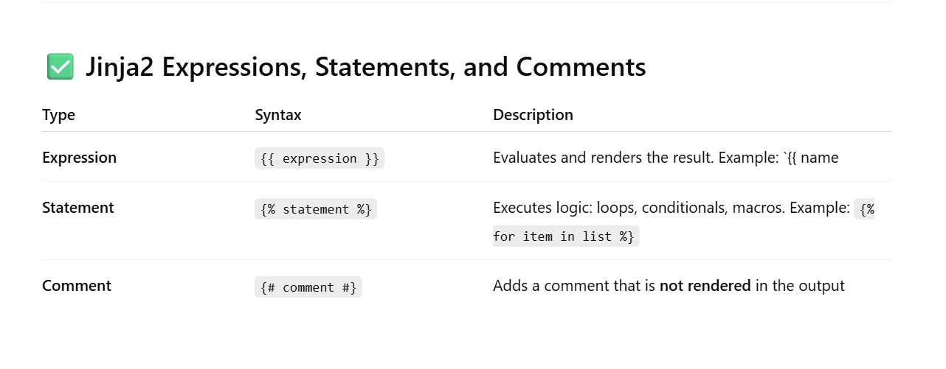
Jinja2
In Ansible, Jinja2 is the templating engine used to dynamically generate content. It lets you insert
variables, apply logic, and manipulate data inside playbooks, templates, and variables.

Slide 84
Jinja2
Statement sample:
- name: debug with jinja2
hosts: servers
become: TRUE
tasks:
- name: debug
debug:
msg: >
{% if ansible_hostname == "node1" %}
your hostname is node1
{% else %}
your hostname is not exist
{% endif %}
How to show all variables in gathering facts? Setup module

Slide 85
Jinja2
Expression sample:
- name: apache webserver install and config
hosts: node1
become: yes
vars:
apache_package: apache2
apache_service: apache2
index_file: /var/www/html/index.html
tasks:
- name: install apache
apt:
name: "{{ apache_package }}"
state: present
- name: ensure start and enabled
service:
name: "{{ apache_service }}"
state: started
enabled: true
- name: generate index.html with Jinja2 template
template:
src: index.html.j2
dest: "{{ index_file }}"

Slide 86
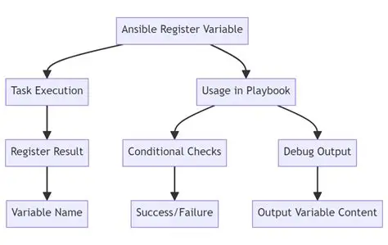
Register Variable
In Ansible, register is used to save the output of a task into a variable so you can use it later in the playbook — for decisions (when), debugging, or further processing.
- name: check nginx install
shell: dpkg -l | grep nginx
register: nginx_check
ignore_errors: yes
- name: if not install - installing
apt:
name: nginx
state: present
when: nginx_check.rc != 0

Slide 87
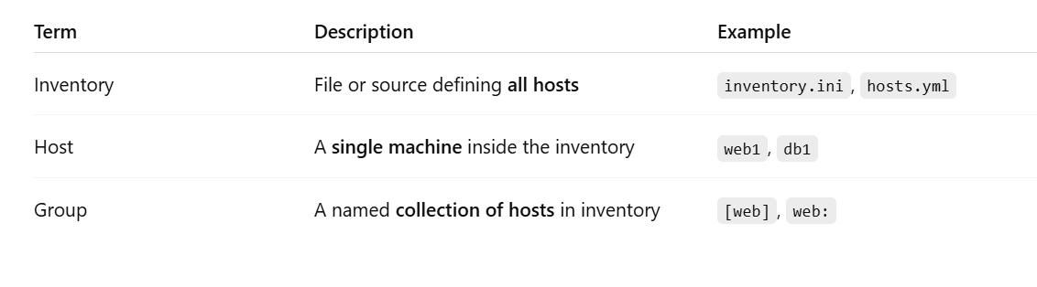
Inventory and host
[web]
web1 ansible_host=192.168.1.10
web2 ansible_host=192.168.1.11
[db]
db1 ansible_host=192.168.1.20
all:
children:
web:
hosts:
web1:
ansible_host: 192.168.1.10
web2:
ansible_host: 192.168.1.11
db:
hosts:
db1:
ansible_host: 192.168.1.20

Slide 88
Ansible tags
What Are Tags in Ansible?
Tags in Ansible let you run specific parts of a playbook instead of executing the whole thing. This is very useful for testing, debugging, or selectively applying configuration
ansible-playbook ansible-apache.yaml --tags install or ansible-playbook anible-apache.yaml --tags "config,restart"

Slide 89
Local Facts
What is a Local Fact in Ansible?Local facts in Ansible are custom host-specific variables stored locally on a managed host. These facts are defined as .fact files on the host and are loaded automatically by the setup module.
/etc/ansible/facts.d/example.fact

Slide 90
Loop
What is a loop in Ansible?A loop in Ansible lets you run a task multiple times, each time with a different item. It's similar to a for loop in programming.
In old version use with_items
- name: Install multiple packages
apt:
name: "{{ item }}"
state: present
loop:
- nginx
- curl

Slide 91
Role
What is a Role in Ansible?
A role in Ansible is a structured, reusable, and modular way to organize your playbook code — including tasks, variables, templates, handlers, files, and more.
Think of a role as a mini-playbook designed to perform a specific function (e.g., installing Nginx, configuring a user, setting up a database).
Why Use Roles?
Better organization
Reusability across projects
Easier to test and maintain
Cleaner and more readable playbooks

Slide 92
Role
roles/
└── nginx/
├── tasks/
│ └── main.yml
├── handlers/
│ └── main.yml
├── templates/
│ └── nginx.conf.j2
├── files/
│ └── custom-index.html
├── vars/
│ └── main.yml
├── defaults/
│ └── main.yml
└── meta/
└── main.yml
ansible-galaxy init nginx

Slide 93
Handler
In Ansible, a handler is a special type of task that only runs when notified by another task. Handlers are typically used to perform actions that should only happen if something changes — like restarting a service after a configuration file is updated.
Notice: if first task before exec for example nginx install handlers not work

Slide 94

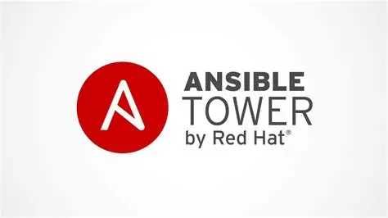
Ansible AWX VS Tower
Feature | AWX | Ansible Tower
What is it? | Open Source and free project by Red Hat. | Commercial, paid product by Red Hat based on AWX.
User Interface | Web UI and API to manage playbooks and jobs. | Web UI and API with enhanced enterprise features and better support.
Support | Community support only. | Official Red Hat support with SLAs.
Features | Provides most core Tower features but has limitations in scale and enterprise capabilities. | Full enterprise capabilities like advanced RBAC, multi-tenancy, detailed reporting, LDAP/AD integration, multi-environment support, etc.
Deployment | Usually installed on Docker or Kubernetes containers, managed by yourself. | Available as a managed service or enterprise installation with full support.
Updates | Usually manual updates managed by your IT team. | Regular updates and maintenance by Red Hat.
Suitable for? | Individuals or small teams with limited budget needing basic management. | Large organizations with complex needs and requirement for official support.

Slide 95
Install awx with docker-compose
wget https://github.com/ansible/awx/archive/17.1.0.zip
unzip 17.1.0.zip
pwgen -N 1 -s 40
Cd installer Edit iventory with your new user and pass and secret key
admin_user=admin
admin_password=yourpassword
secret_key=from pgen
ansible-playbook -i inventory install.yml

Slide 96
Poll and async
What does poll mean in Ansible?In Ansible, poll is used along with async to control how long Ansible waits for a long-running task
- name: Long running task
command: /path/to/script.sh
async: 600 # Run the task in background (max 10 min)
poll: 10 # Check every 10 seconds until it's done
| async | poll | Meaning |
| ----- | ---- | -------------------------------------------------------- |
| 600 | 10 | Run task, and check every 10 seconds until done |
| 600 | 0 | **Fire and forget** (start task and move on immediately) |
| 0 | any | Invalid — `async` must be > 0 if `poll` is used |

Slide 97
🎯 How to Tune Ansible for High Performance
Increase forks for more parallel tasksBy default, Ansible runs on only 5 hosts at a time
Disable gather_facts when not needed
Use async + poll for long-running tasks
Switch to free strategy for true parallelism
Reduce verbosity (use minimal callback)
Enable fact caching

Slide 98
🎯 How to Tune Ansible for High Performance
[defaults]
# Increase parallel connections (default is 5) /etc/ansible.cfg
forks = 50
# Reduce log output (minimal or json for machine-readable)
stdout_callback = minimal
# Disable fact gathering by default (can override in playbook)
gathering = smart
fact_caching = jsonfile
fact_caching_connection = /tmp/ansible-facts
# Use better parallel strategy
strategy = free

Slide 99
🎯 How to secure Ansible
Protect Sensitive Files (Passwords, Secrets)Best Practice: Use Ansible Vault to encrypt secret files
Use Non-Root Users + sudo
Install Roles/Collections from Trusted Sources
Enable Logging for Auditing (Keeps track of who ran what and when — helpful for audits or investigating suspicious actions.)

Slide 100
Monitoring
What is monitoring?
Checking and watching something regularly to see if it is working correctly.
.
Type | Purpose
Infrastructure | Monitors servers, containers, cloud
Application | Monitors code performance, response time
Network | Monitors routers, traffic, packet loss
Log Monitoring | Analyzes logs for errors and patterns
Synthetic | Simulates user activity to test uptime
Real User | Tracks actual user interactions
:

Slide 101
three key concepts in monitoring
High Resolution Monitoring
Definition: Collecting data very frequently (e.g., every 5 seconds instead of every minute).
Why it's important:
Lets you see problems sooner (like CPU spikes).
Helps with real-time alerts and precise debugging.
Prometheus (scrape_interval = 5s)
Latency
Definition: The time it takes to complete a request or operation (usually in milliseconds).Why it's important:High latency = slow system = bad user experience.Latency is one of the "Golden Signals" in SRE
High Diversity
Definition: Monitoring a wide range of systems, services, and data types.Why it’s important:Modern systems are complex and distributed.You need metrics, logs, traces, and events across:APIsMicroservicesNetworksDatabasesContainers (Docker, Kubernetes)
:

Slide 102
three key concepts in monitoring
Concept | Meaning | Why It Matters
High Resolution | Frequent data collection | Better detection + faster alert
Latency | Delay in response time | Impacts user experience
High Diversity | Multiple data types & sources | Full system observability
:

Slide 103
Main Monitoring Components
🔢 No. | 🧩 Component | 📝 Description | 🛠️ Common Tools/Examples
1 | Metrics Collector | Gathers numeric data like CPU, memory, response time | Prometheus, Telegraf, Datadog Agent
2 | Time Series Database | Stores time-based metric data | Prometheus, InfluxDB, VictoriaMetrics
3 | Visualization | Shows data in graphs and dashboards | Grafana, Kibana, Datadog UI
4 | Alerting System | Sends alerts when thresholds or issues occur | Alertmanager, Grafana Alerts, PagerDuty
5 | Log Collector | Gathers logs from systems and applications | Fluentd, Filebeat, Logstash
6 | Log Storage & Search | Stores logs and allows fast search/filter | Elasticsearch, Loki, Graylog
7 | Tracing System | Follows a single request across multiple services | Jaeger, Zipkin, OpenTelemetry
8 | Monitoring Agent | Installed on nodes/services to expose metrics | Node Exporter, cAdvisor, WMI Exporter
9 | Synthetic Monitoring | Simulates user behavior to test service availability | Blackbox Exporter, Pingdom, UptimeRobot
10 | Event Processor | Reacts to events like service restart or log error | Kapacitor, Amazon EventBridge, Prometheus rules
:

Slide 104
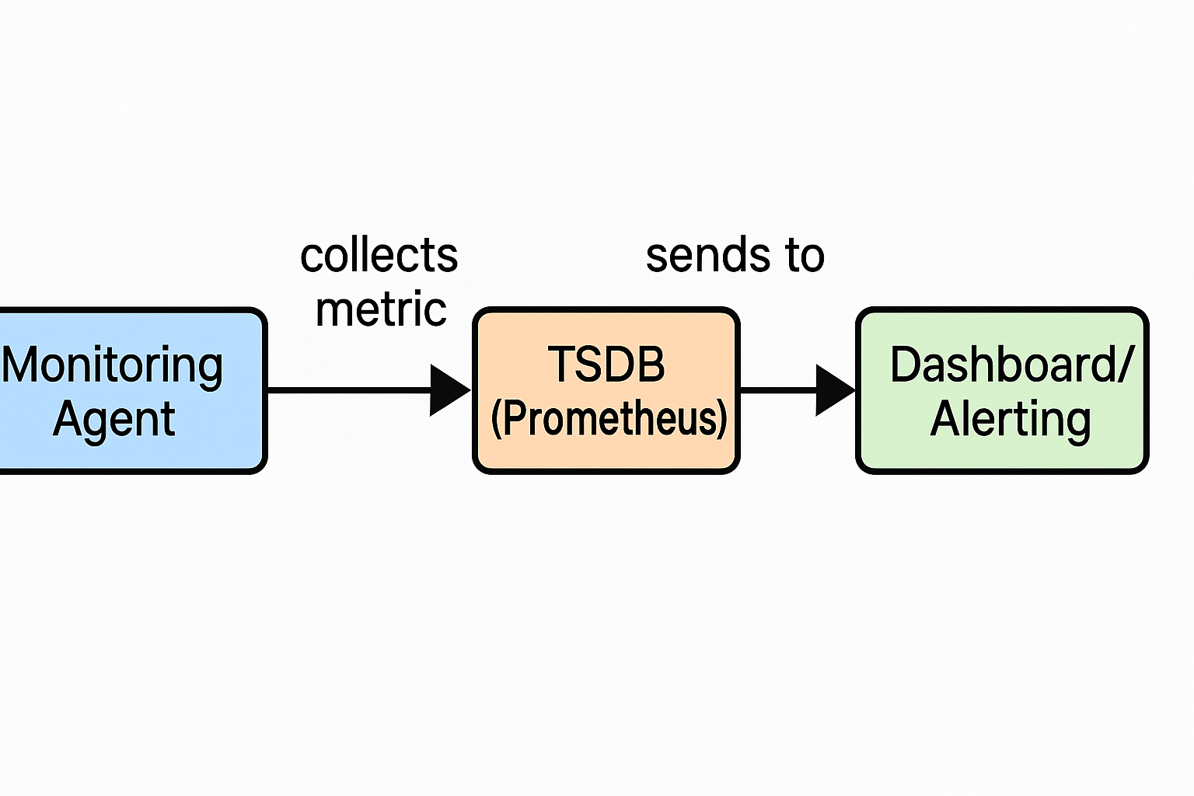
Main Monitoring Components
| **Timestamp** | **Metric Name** | **Value** | **Labels (Tags)** |
| ------------------- | ------------------- | --------- | ----------------- |
| 2025-07-16 00:00:00 | `cpu_usage_percent` | 23.5 | server="server1" |
| 2025-07-16 00:00:10 | `cpu_usage_percent` | 25.2 | server="server1" |
| 2025-07-16 00:00:20 | `cpu_usage_percent` | 22.8 | server="server1" |
| 2025-07-16 00:00:30 | `cpu_usage_percent` | 30.1 | server="server1" |
epocconertor
Tsdb sample
cpu_usage_percent{server="web01"} 35.2 this is metric
Metric = single piece of information (name + value + labels)
TSDB = storage engine that holds time-based metric data
:

Slide 105
White vs black vs gray box
Aspect | White Box | Black Box | Gray Box
Visibility | Full internal access | No internal access | Partial internal access
Data Collected | Metrics, logs, traces, internals | External availability, response | Mix of internal metrics + external tests
Use Cases | Deep performance analysis | Uptime and availability checks | Hybrid monitoring
Pros | Detailed root cause analysis | Easy to implement | Balanced insight
Cons | Complex, needs access | Limited insight | Partial visibility
:

Slide 106
Metric metod collect
1- Pull base or passive monitroring
2- Push base or active monitoring
Bonus: When to use which?
Use Pull if:Your monitoring server can reach targets directlyTargets are long-lived services with stable network addressesYou want centralized control over scraping frequencyUse
Push if:Targets are behind firewalls or NAT, unreachable by monitoring serverYou want the client to decide when metrics are sent
:

Slide 107
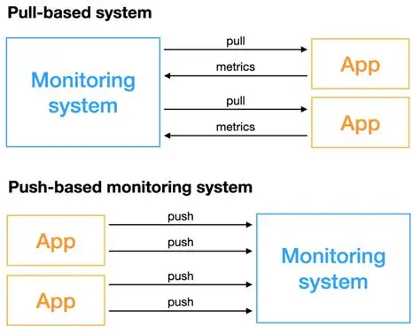
Metric metod collect
:

Slide 108
4 The Four Golden Signals (Google SRE)
Signal | What it Measures | Why it's Important
Latency | Time taken to serve a request | High latency means slow performance; users perceive lag or delays
Traffic | Amount of demand on the system (e.g., QPS, RPS, bytes/sec) | Shows how much load your system is handling
Errors | Rate of failed requests (HTTP 500, exceptions, etc.) | Tracks reliability; error spikes usually mean something’s broken
Saturation | System utilization vs. capacity (e.g., CPU, memory, queue length) | Indicates how "full" your system is; predicts potential bottlenecks or slowdowns
:

Slide 109

Prometheus
Prometheus is an open-source monitoring and alerting system designed for reliability, scalability, and simplicity — originally developed at SoundCloud and now part of the Cloud Native Computing Foundation (CNCF).
It is one of the most popular tools for time-series data monitoring, especially in cloud-native environments like Kubernetes.
https://prometheus.io
:

Slide 110
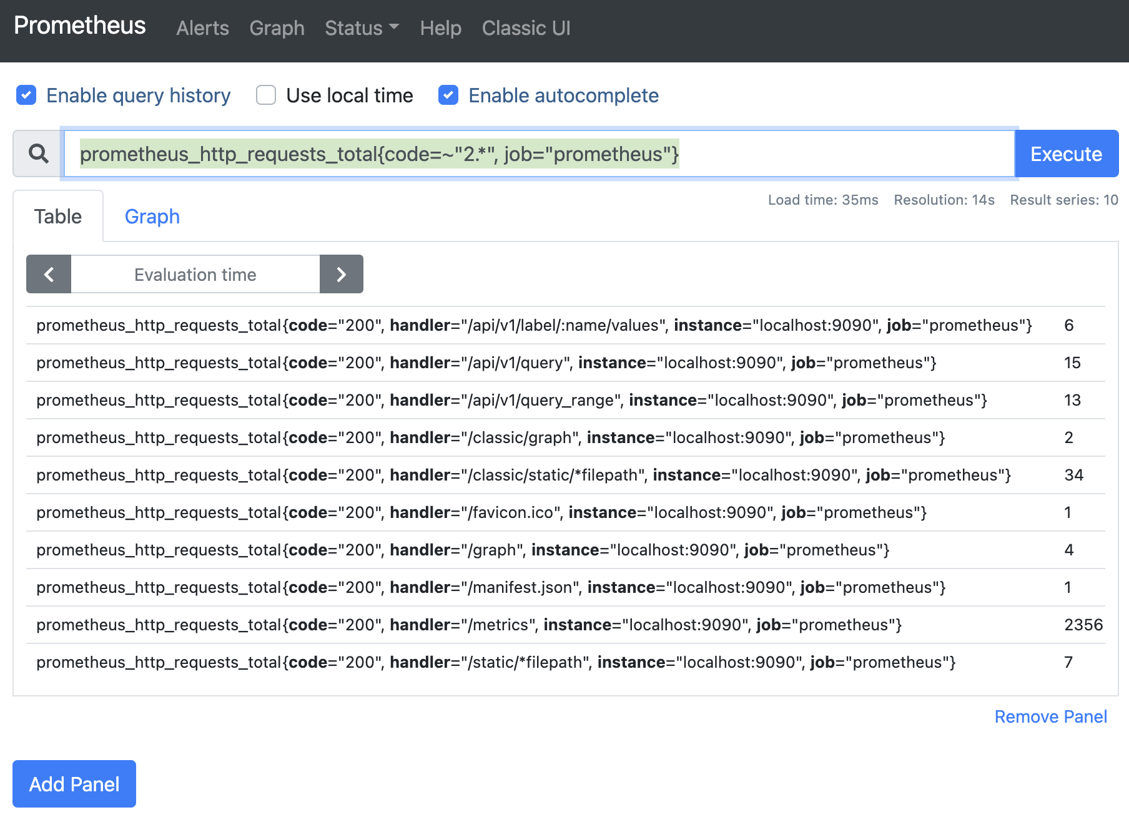
Prometheus
What is PromQL?
PromQL (Prometheus Query Language) is the powerful and flexible query language used by Prometheus to extract and analyze time-series metrics.It's what allows you to:Query current or historical metricsPerform calculations (rates, averages, percentiles)Filter by labels (e.g., method="GET")Build alerts and dashboards
:

Slide 111
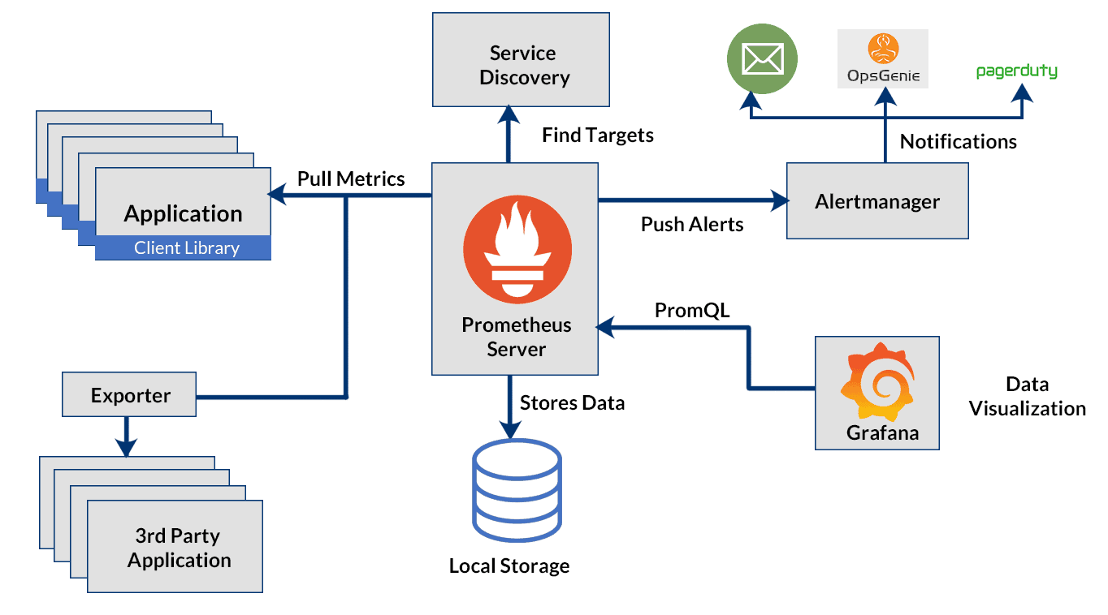
Prometheus Architecture
Component | Description
Prometheus Server | The heart of the system — scrapes metrics, stores data in TSDB, runs queries
Exporters | Small programs that expose metrics in Prometheus format via HTTP endpoints
Pushgateway | Accepts metrics from short-lived jobs (only if push model is needed)
Alertmanager | Handles alerts sent by Prometheus; routes them to email, Slack, etc.
Service Discovery | Automatically discovers scrape targets (Kubernetes, EC2, etc.)
Grafana / Web UI | Tools for visualizing metrics and queries
:

Slide 112
exporter vs libary client
In Prometheus, Exporters and Client Libraries are two different methods of exposing metrics, depending on how much control you have over the target system:
Exporter
Definition: A separate program that collects metrics from a third-party system and exposes them in a Prometheus-compatible format
Example:
node_exporter → Exposes Linux system metrics.
mysql_exporter → Exposes MySQL metrics.
blackbox_exporter → Probes endpoints (HTTP, TCP, etc.).
Client Library
Definition: A programming library that developers integrate into their own applications to expose custom metrics.
Use case: When you can modify the application's source code.
Available for: Go, Python, Java, Ruby, etc.
:

Slide 113
exporter vs libary client
In Prometheus, Exporters and Client Libraries are two different methods of exposing metrics, depending on how much control you have over the target system:
Exporter
Definition: A separate program that collects metrics from a third-party system and exposes them in a Prometheus-compatible format
Example:
node_exporter → Exposes Linux system metrics.
mysql_exporter → Exposes MySQL metrics.
blackbox_exporter → Probes endpoints (HTTP, TCP, etc.).
Client Library
Definition: A programming library that developers integrate into their own applications to expose custom metrics.
Use case: When you can modify the application's source code.
Available for: Go, Python, Java, Ruby, etc.
:

Slide 114
How Data store?
Head Block (In-Memory)
Recent data is written to the head block:
Lives in memory.
Flushed to disk every 2 hours.
Fast write access.
WAL (Write-Ahead Log)
Prometheus first writes incoming samples to a WAL file.
Ensures durability: If it crashes, it replays the WAL on restart.
WAL is eventually compacted into blocks
Chunks
Samples are grouped into chunks (compressed blocks of time-series data).
Each chunk holds samples for a single time series (usually ~2 hours worth).
Stored in a compressed format using delta encoding or XOR compression.
Persistent Blocks
Every 2 hours, data from the head is flushed into TSDB blocks on disk:Each block = 2h of dataStored in: /var/lib/prometheus/metrics2/wal and /chunks_head/ directories (default path)
:

Slide 115
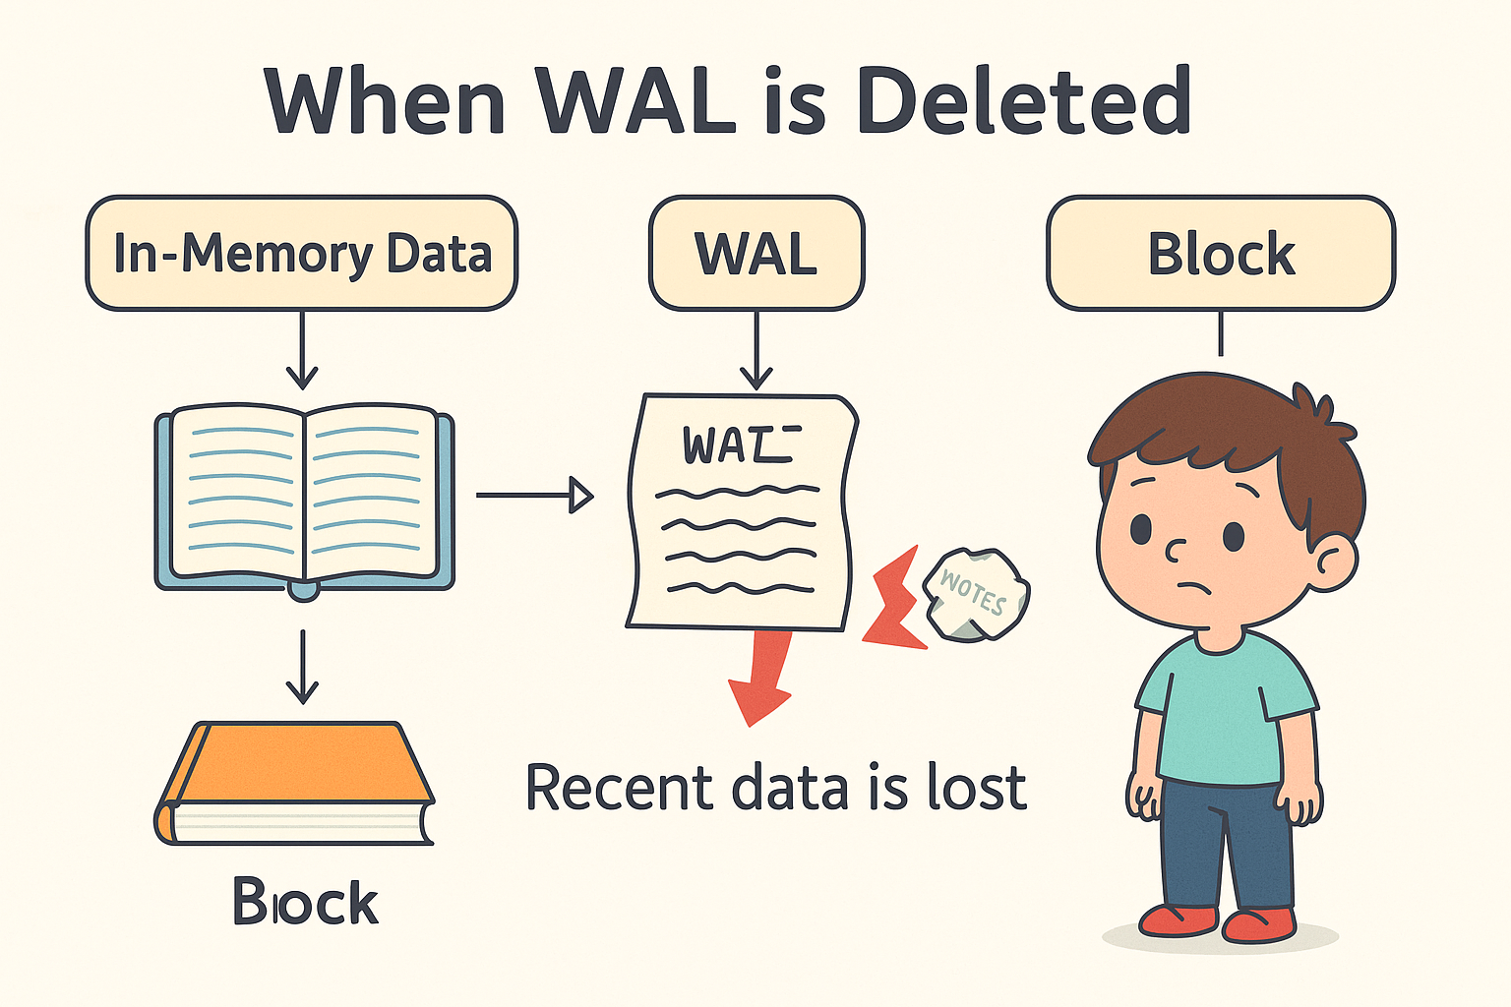
How Data store?
:

Slide 116
How Data store?
Compaction
Older blocks are compacted:
Merges smaller blocks into bigger ones
Reduces disk space
Improves query performance
Tombstone?
Retention & Deletion:
Default retention is 15 days (can be configured).Prometheus deletes old blocks based on retention settings.
--storage.tsdb.retention.time=30d
:

Slide 117
Cardinality
Cardinality in Prometheus (and generally in monitoring) refers to the number of unique combinations of labels for a metric../
http_requests_total{method="GET", status="200", user="john"}
Now imagine you have:
5 HTTP methods (GET, POST, etc.)
10 status codes
1,000 usersThat’s potentially: 5 × 10 × 1,000 = 50,000
📈 Why it matters:
📉 More cardinality = more memory and CPU usage in Prometheus
🚫 Very high cardinality can crash Prometheus or make it slow
:

Slide 118
metric types
1-.Counter
Only increases (or resets to 0)
Good for: total requests, errors, jobs completed
2. Gauge
Can increase or decrease (live show)
Good for: memory usage, CPU load, temperature
3. Histogram
Measures distributions of values (e.g., request durations)Stores:*_bucket: count in each bucket*_count: total count*_sum: total sumGood for: request duration, response sizes
4. Summary
Like Histogram, but gives:quantiles (e.g., 95th percentile)*_count and *_sumGood for: small-scale latency measurement
:

Slide 119
Query in prometheus
What is a Query in Prometheus?
A Prometheus query is written in PromQL (Prometheus Query Language). It lets you retrieve and process time-series data.
Sample query
http_requests_total{method="GET", status="200"}
rate(http_requests_total[5m])
By default
--query.max-concurrency=2o
--query.timeout 2m Timeout per query
🚨 Note
Be careful increasing it too much — it can:
Consume too much memory/CPU
Slow down or crash your instance if overloaded
:

Slide 120
Query in prometheus
In Prometheus, query.lookback-delta (often referred to as “query back delta”) is a setting that defines how far back in time Prometheus looks when evaluating "instant" queries
By default
--query.lookback-delta=5m
Means when find for metric on 12.50 if exist metric on 12.45 valid and show but if 12.44 not show
When change it ? ☺
:

Slide 121
Prometheus.yml
# Global configuration
global:
scrape_interval: 15s # Default scrape interval for targets (every 15 seconds) (http request)
scrape_timeout: 10s # Timeout for scraping metrics from a target
evaluation_interval: 15s notice evaluate interval == scrape interval
scrape_configs:
# Scrape Prometheus itself
- job_name: 'prometheus'
static_configs:
- targets: ['localhost:9090'] # Prometheus internal metrics
Notice scrape interval > 150s gap in dashboard
:

Slide 122
Lables
What are Labels in Prometheus?
Labels are like tags that add extra information to each metric.
They help you:
filter data
group data
understand where a metric came from
http_requests_total{job="webserver", method="GET", status="200"}
count without (device,id) (container_fs_reads_total)
What’s a Label Matcher?
Label matchers are used inside {} to filter metrics by label.
:

Slide 123
Lables
Matcher | Meaning | Example
= | Exact match | {status="200"}
!= | Not equal | {job!="node_exporter"}
=~ | Regex match | {instance=~"server.*"}
!~ | Regex NOT match | `{method!~"GET
:

Slide 124
Relabeling
What is Relabeling?
Relabeling is how
Prometheus changes or filters targets before scraping them.It’s like a set of rules to:
1-Rename labels
2-Add new labels
3-Remove targets you don’t want
4-Change the target address (IP and port)
For example
Add a custom label:yaml
label_configs:
target_label: env means add env=“production”
replacement: production
:

Slide 125
Instance vector and offset
1. Instance Vector
An instance vector refers to a set of time series (metrics) filtered by the instance label.
Purpose: Isolate metrics from a specific target (e.g., a server, pod, or application instance).
http_requests_total{instance="10.0.0.1:8080"}
2. Offset
The offset modifier shifts the query's time window backward by a specified duration.
Purpose: Compare current data with past data (e.g., "1 hour ago").
http_requests_total offset 1h
:

Slide 126
Arithmetic Binary Operators
Prometheus supports arithmetic operations between scalars, vectors, or scalars and vectors using binary operators. These perform mathematical computations on time series data.
Operators:
+ (addition)
- (subtraction)
* (multiplication)
/ (division)
% (modulo)
:

Slide 127
Usefull query in Cadvisor
CPU Usage (percentage) per container
rate(container_cpu_usage_seconds_total{name!="", image!=""}[1m]) * 100
Memory Usage in MB
container_memory_usage_bytes{name!=""} / 1024 / 1024
Disk I/O – Write Bytes per container
rate(container_fs_writes_bytes_total{name!=""}[1m])
Top 5 containers by memory
topk(5, container_memory_usage_bytes)
topk(5, max(container_memory_usage_bytes{name!=""}) by (name))
:

Slide 128
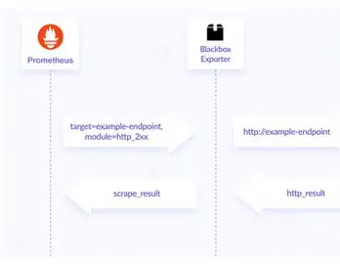
Black box exporter
What is Blackbox Exporter in Prometheus?
The Blackbox Exporter is a Prometheus exporter used to probe endpoints over the network—like HTTP(S), DNS, TCP, or ICMP (ping)—to check their availability, latency, and response status. It's called "blackbox" because it doesn't care what's inside the service—only that it responds properly from the outside.
Use cases:
Is my website reachable from the outside?
Can I ping a server?
Is my DNS server resolving names?
Is port 443 open and serving HTTPS?
:

Slide 129
Black box exporter
What is Blackbox Exporter in Prometheus?
The Blackbox Exporter is a Prometheus exporter used to probe endpoints over the network—like HTTP(S), DNS, TCP, or ICMP (ping)—to check their availability, latency, and response status. It's called "blackbox" because it doesn't care what's inside the service—only that it responds properly from the outside.
Probe success=0 means fail ☹
Prob success = 1 mean okay ☺
Sample query in blackbox
What is probe?
A test sent to an endpoint (e.g., http://example.com) to check whether it is up and how fast it responds
http://localhost:9115/probe?module=icmp&target=digikala.com
:

Slide 130
Black box exporter
http://188.121.102.240:9115/probe?target=188.121.102.240:9082&module=tcp_connect
For check port open or close
http://188.121.102.240:9115/probe?target=digikala.com&module=dns_check
For dns resolve
debug-=true show many log
http://188.121.102.240:9115/probe?module=http_2xx&target=digikala.com&debug=true
http://188.121.102.240:9115/probe?module=http_2xx&target=portalcando.ir&debug=true
http://188.121.102.240:9115/probe?module=asghar_ssl&target=portal.cando.ac&debug=true
Check ssl fail or succes
:

Slide 131
Service Discovery
What is Service Discovery in Prometheus?
Service discovery in Prometheus is the mechanism by which it dynamically finds targets (exporters or instrumented applications) to scrape metrics from, rather than relying only on static configuration.This is essential in dynamic environments like Kubernetes, where services and pods are frequently added or removed.
Kubernetes (Most Popular)Highly dynamic, uses Kubernetes API to find targets (Pods, Services, Endpoints, Nodes, etc.)
🐳 Docker SwarmUses Docker labels and APIs to find services and tasks.
☁️ Cloud Provider-basedPrometheus supports automatic discovery for:
Ansible Playbook: Use Ansible to discover hosts and generate JSON files with Prometheus target definitions.
:

Slide 132
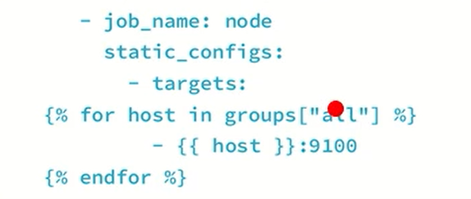
Service Discovery
:

Slide 133
Service Discovery
file_sd_configs is a Prometheus feature that allows it to read target lists (i.e. what to monitor) from JSON or YAML files. These files define the scrape targets and optional labels.
scrape_configs:
- job_name: 'node_exporter'
file_sd_configs:
- files:
- 'targets/node_exporter_targets.json'
refresh_interval: 30s
This is file (node_exporter_targets.json)
[
{
"targets": ["10.0.0.1:9100", "10.0.0.2:9100"],
"labels": {
"env": "production",
"role": "web"
}
:

Slide 134
Prometheus Federation
What is Prometheus Federation?
Federation is a method to aggregate and centralize metrics from multiple Prometheus servers by having one Prometheus server scrape metrics from others.
Why use Federation?
Scale Prometheus horizontally (e.g., multiple Prometheus instances collecting metrics from different clusters or regions)
Centralize metrics in a single Prometheus for global queries or long-term storage
Separate concerns: local Prometheus for scraping local targets, federated Prometheus for global visibility
:

Slide 135
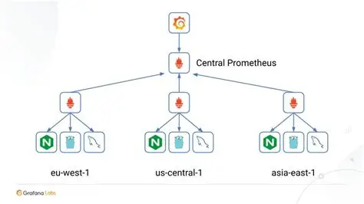
Prometheus Federation
:

Slide 136
Rules
In Prometheus, a rule is a way to process or act on time series data automatically. There are two types of rules:
Why use them?
Reduce load by reusing heavy queries
Create custom metrics (e.g. http_errors_total)
- record: job:cpu_usage:avg
expr: avg(rate(container_cpu_usage_seconds_total[5m])) by (job)
:

Slide 137
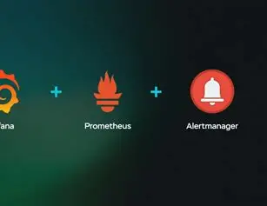
Alert Manager
What is Alertmanager?
Part of the Prometheus ecosystemResponsible for:Managing alerts sent by PrometheusGrouping, deduplicating, and routing alertsSending notifications (e.g., email, Slack, PagerDuty)
[ Prometheus ] → [ Alertmanager ] → [ Slack / Email / etc. ]
:

Slide 138
Alert Manager
1-Prometheus triggers alerts based on rules
2-Alertmanager receives them
3-Sends them to people or systems
Scenario:Your server’s CPU is over 90% for 5 minutes →
Alert is triggeredFlow:
Prometheus sees it via alert rule
Sends alert to Alertmanager
Alertmanager sends it to Slack
:

Slide 139
Alert Manager
global:
smtp_smarthost: 'smtp.example.com:587'
smtp_from: 'alert@example.com'
route:
receiver: 'email-notifications'
receivers:
- name: 'email-notifications'
email_configs:
- to: 'team@example.com'
:

Slide 140
MySQL Exporter
MySQL Exporter If you’re looking to monitor MySQL performance and expose metrics for Prometheus, there’s a popular open-source tool called mysqld_exporter by Prometheus.It connects to MySQL and exports server stats (queries per second, connections, replication status, etc.) as Prometheus metrics.Useful for monitoring MySQL in a cloud-native environment.
:

Slide 141
MySQL Exporter vs Datasource MySQL
Aspect | MySQL Exporter | MySQL Datasource in Grafana
What data is accessed? | MySQL server metrics (performance stats) | Actual data stored in MySQL tables
Who consumes data? | Prometheus scrapes exporter metrics | Grafana queries MySQL directly with SQL
Typical output | Metrics in Prometheus format (time-series data) | Query results (tabular data)
Usage scenario | Infrastructure monitoring | Business data visualization and reporting
Setup complexity | Requires running exporter service + Prometheus | Connect directly via Grafana datasource settings
:

Slide 142
MySQL Exporter
CREATE USER 'mysqld_exporter'@'localhost' IDENTIFIED BY 'your_password’;
GRANT PROCESS, REPLICATION CLIENT, SELECT ON *.* TO 'mysqld_exporter'@'localhost’;
FLUSH PRIVILEGES;
PROCESS, REPLICATION CLIENT, SELECT:These are the specific privileges being granted to the user mysqld_exporter.
PROCESS:Allows the user to see information about running threads/processes on the MySQL server. This is important to get details like active queries, status of server threads, which are useful for monitoring.
REPLICATION CLIENT:Allows the user to ask the server about its replication status and control replication connections (important if you’re monitoring replication lag and related metrics).
SELECT:Gives permission to perform SELECT queries (read-only) on tables. This is necessary because the exporter reads data from MySQL’s internal performance tables and schemas.
[client]
user=mysqld_exporter
password=your_password
./mysqld_exporter --config.my-cnf=./my.conf
Add in Prometheus.ym as target
:

Slide 143
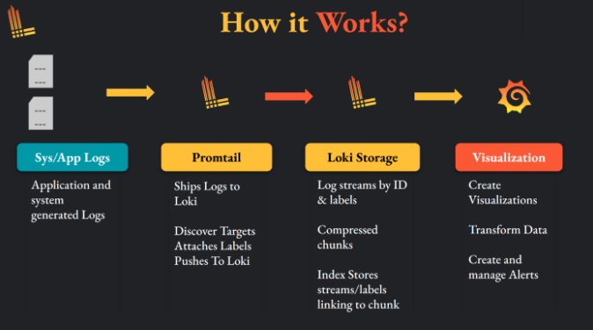
Loki promtail Grafana schema
:

Slide 144

Loki
What is Loki?
Loki is an open-source log aggregation system created by Grafana Labs. It’s designed to collect, store, and query logs from your applications and infrastructure — but with a very efficient, cost-effective, and scalable approach.
:

Slide 145
Loki
Purpose:
Loki is made to aggregate and search logs from many sources, similar to tools like Elasticsearch + Kibana, but it’s built to be simpler and cheaper to operate.
How it works:
Unlike traditional logging systems that index the full contents of logs (which can be very expensive and resource-heavy), Loki indexes only metadata (labels) like application name, instance, or environment, and stores the actual log content compressed and unindexed.This makes Loki much more efficient in terms of storage and performance, especially for large volumes of logs.
Integration with Grafana:
Loki integrates seamlessly with Grafana — you can visualize logs alongside your metrics in unified dashboards.Inspiration:Loki was inspired by Prometheus, which indexes time series metrics using labels. Loki applies a similar idea for logs.
:

Slide 146
Loki
Why use Loki?
1-Cost-effective: Lower storage and operational costs compared to traditional log systems.
2-Easy to use: Tight integration with Grafana makes log exploration intuitive.
3-Scalable: Designed for large-scale log aggregation.
4-Multi-tenant support: Can separate logs by team or environment easily.
:

Slide 147
Loki
auth_enabled: false # Disable authentication; no login needed to access Loki
server: # Server settings for Loki
http_listen_port: 3100 # HTTP port Loki listens on (for API requests)
grpc_listen_port: 9095 # gRPC port Loki listens on (used internally)
ingester: # Config for the ingester component that buffers and writes logs
lifecycler: # Handles lifecycle and membership of ingesters in a cluster
address: 127.0.0.1 # IP address of this ingester instance
ring: # Ring configuration for ingester clustering and data distribution
kvstore: # Key-value store backend for ring state
store: inmemory # Use in-memory store (not persistent, single-node setup)
replication_factor: 1 # Number of ingesters to replicate data to (1 = no replication)
chunk_idle_period: 5m # Time after which idle chunks are flushed to storage (5 minutes)
max_chunk_age: 1h # Maximum age of a chunk before it is flushed (1 hour)
chunk_target_size: 1048576 # Target size in bytes (~1MB) for chunks before flushing
schema_config: # Schema and storage configuration for indexing
configs:
- from: 2020-10-24 # Effective date of this schema config
store: boltdb-shipper # Use BoltDB Shipper as the index store (efficient local index)
object_store: filesystem # Store log chunks on local filesystem
schema: v11 # Version 11 of Loki’s storage schema
index: # Index file config
prefix: index_ # Prefix for index files stored on disk
period: 24h # Index files are rotated daily (every 24 hours)
storage_config: # Configuration for how and where Loki stores data
boltdb_shipper: # Config for BoltDB Shipper index store
active_index_directory: /tmp/loki/index # Directory for active index files
cache_location: /tmp/loki/cache # Directory for cached index data
shared_store: filesystem # Shared storage type (filesystem in this case)
filesystem: # Storage backend for log chunks
directory: /tmp/loki/chunks # Directory to store log chunks on disk
limits_config: # Limits and validation settings
enforce_metric_name: false # Disable enforcing Prometheus metric name rules (not relevant for logs)
reject_old_samples: true # Reject log entries older than a certain age
reject_old_samples_max_age: 168h # Max age (in hours) for accepted log samples (168h = 7 days)
:

Slide 148
Promtail
What is Promtail?
Promtail is an open-source agent designed to collect logs from your local machine and send them to Loki for storage and querying.
Key points about Promtail:
Purpose:It tails (reads) log files from your system (like /var/log/syslog, application logs, etc.) and ships those logs to Loki.
How it works:Promtail monitors specified log files in real-time, adds labels (metadata) to each log line (like hostname, app name, or environment), and pushes the logs to Loki's HTTP API.
Part of the Loki stack:Promtail is one piece of the Loki logging system, alongside Loki server (which stores logs) and Grafana (which visualizes logs).
Configurable:You can tell Promtail exactly which files to watch and how to label the logs for easier querying later in Grafana.
:

Slide 149
Promtail
server:
http_listen_port: 9080 # The port Promtail exposes for health and metrics endpoints
grpc_listen_port: 0 # Set to 0 to disable gRPC (not needed in most simple setups)
positions:
filename: /tmp/positions.yaml # File to track how much of each log has been read
clients:
- url: http://localhost:3100/loki/api/v1/push # The URL of your Loki server (Promtail pushes logs here)
scrape_configs:
- job_name: system # A name for this log scraping job (used as a label in Loki)
static_configs:
- targets:
- localhost # Required field, but unused for file targets
labels:
job: varlogs # This label will appear in Loki/Grafana, you use it to query logs (e.g. {job="varlogs"})
__path__: /var/log/*log # Files to collect logs from; *log matches files like syslog, auth.log, dpkg.log, etc.
:

Slide 150

Redis
Redis is an open-source, in-memory data structure store that is commonly used as:a database,a cache, anda message broker
What makes Redis special?
⚡ Very fast: It stores data in memory (RAM), making reads and writes extremely quick.
🧠 Key-Value Store: Like a dictionary or hashmap – you store data as key-value pairs.
🔁 Supports complex data types: Not just strings! It supports:
| Use Case | Description |
| ----------------- | ------------------------------------------------------ |
| **Cache** | Store frequently accessed data to reduce load on DB. |
| **Session Store** | Store user sessions for web apps (e.g., login info). |
| **Rate Limiting** | Track how many times a user/IP does something. |
| **Leaderboard** | Use sorted sets to build real-time ranking systems. |
| **Message Queue** | Use lists or streams to implement a lightweight queue. |
:

Slide 151

Kubernetes
What is Kubernetes?
Kubernetes (K8s) is an open-source, next-generation container orchestration platform originally developed at Google. It was built using the lessons learned from running large-scale systems like Borg and Omega.
Designed from the ground up, Kubernetes is a loosely coupled set of components that work together to automate the deployment, management, and scaling of containerized applications.
:

Slide 152
Kubernetes
What Kubernetes Does?
Kubernetes (K8s) is a container orchestration platform. Its main job is to manage containers (like Docker containers) in production at scale.
Here’s what it does:
Deployment & Management – Runs your applications in containers and makes sure they’re deployed correctly.
2.Scaling – Automatically increases or decreases the number of containers based on demand.
3.Load Balancing – Distributes traffic between containers so no single container is overloaded.
4.Self-Healing – Restarts failed containers, replaces unhealthy ones, and reschedules them if a node goes down.
5.Service Discovery & Networking – Makes containers find and talk to each other securely.
6.Storage Orchestration – Automatically mounts and manages storage for applications.
7.Automated Rollouts & Rollbacks – Updates your applications with zero downtime and rolls back if something goes wrong.
:

Slide 153
Kubernetes Architecture
Control Plane (formerly called “Master”)
Acts as the brain of the cluster.
Runs the API Server, Scheduler, and Controller Manager.
Maintains the desired state of the cluster (what apps should run, how many replicas, networking, etc.).
etcd, the key-value store that saves all cluster state and configuration.
Nodes (Workers)
These are the machines (VMs or physical servers) that run your application workloads.
Each node runs:
Kubelet → agent that communicates with the control plane and ensures containers are running as instructed.
Kube-proxy → handles networking and load balancing inside the cluster.
A container runtime (e.g., Docker, containerd, CRI-O) → actually runs the containers.
Nodes execute workloads (Pods) as scheduled by the control plane.
:

Slide 154
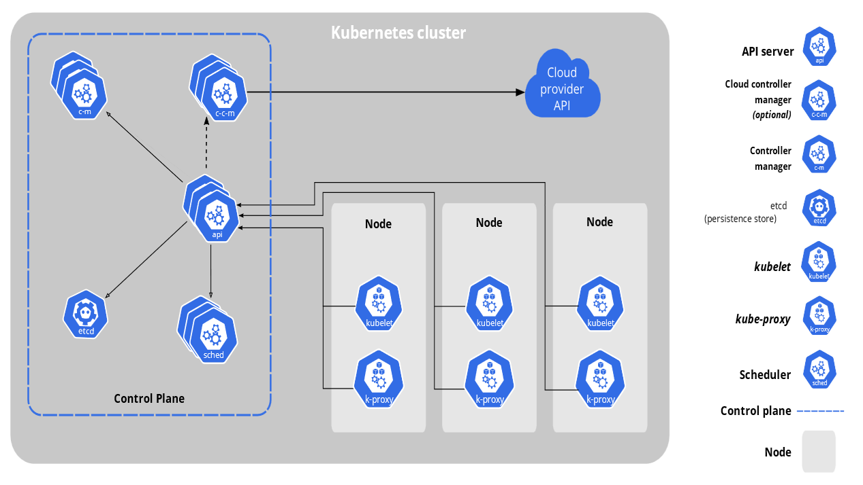
Kubernetes Architecture
:

Slide 155
kube-apiserver (API Server)
The API server is the central management component of the Kubernetes control plane.It exposes a RESTful API that all clients (users, kubectl, controllers, nodes, and external apps) use to interact with the cluster.It is the front-end of the Kubernetes control plane and the only entry point to the etcd datastore (which stores cluster state).
Key responsibilities:
Authentication & Authorization – Validates who is making the request and whether they are allowed to perform the action.
Request Validation – Ensures requests are well-formed and conform to Kubernetes API rules.
Admission Control & Mutation – Runs admission controllers that can reject or modify (mutate) requests before persisting them.
State Management – Updates etcd with the desired state and serves that state back to clients.
Cluster Gateway – All communication (from users, nodes, or controllers) flows through the API server
:

Slide 156

etcd
etcd (Kubernetes Datastore)etcd is a distributed, reliable, and strongly consistent key-value store.It acts as the source of truth for the Kubernetes cluster, persisting all cluster data.Stores the entire cluster state, including:
Node information
Pod definitions
ConfigMaps & SecretsService accounts,
roles, and other API objects
:

Slide 157
kube-controller-manager
The controller manager is a daemon that runs the control loops responsible for keeping the cluster in the desired state.It continuously watches the cluster state through the kube-apiserver, then takes action to move the cluster toward the desired state defined by the user.Think of it as the “automation engine” of Kubernetes.
Node Controller – Detects and responds when nodes go down.
Replication Controller – Ensures the correct number of Pod replicas are running.
:

Slide 158
kube-scheduler
It watches for newly created Pods that don’t have a Node assigned yet, then selects a suitable Node for them
The kube-scheduler is the component of the control plane responsible for assigning Pods to Nodes.It watches for newly created Pods that don’t have a Node assigned yet, then selects a suitable Node for them
Factors it considers:
1-Hardware requirements (CPU, memory, GPUs, etc.)
2-Node affinity / anti-affinity rules
3-Pod affinity / anti-affinity rules
4-Taints and tolerations
:

Slide 159
kubelet
It watches for newly created Pods that don’t have a Node assigned yet, then selects a suitable Node for them
The kubelet is the node agent that runs on every worker node in a Kubernetes cluster.Its primary job is to manage the lifecycle of Pods scheduled to that node.It communicates with the kube-apiserver, receives Pod specifications, and ensures containers are running and healthy.
key responsibilities:
Pod Lifecycle Management – Starts, stops, and monitors containers defined in PodSpecs.
Health Monitoring – Reports node and Pod status back to the control plane.
Container Runtime Interface (CRI) – Interacts with container runtimes like containerd, CRI-O, or Docker (deprecated).
CNI & CSI Integration – Works with networking (CNI) and storage (CSI) plugins to provide Pods with networking and persistent storage.
Static Pods – Can still read Pod manifests from a local file path (e.g., /etc/kubernetes/manifests/) for critical system Pods like kube-proxy
:

Slide 160
kubelet
It watches for newly created Pods that don’t have a Node assigned yet, then selects a suitable Node for them
The kubelet is the node agent that runs on every worker node in a Kubernetes cluster.Its primary job is to manage the lifecycle of Pods scheduled to that node.It communicates with the kube-apiserver, receives Pod specifications, and ensures containers are running and healthy.
key responsibilities:
Pod Lifecycle Management – Starts, stops, and monitors containers defined in PodSpecs.
Health Monitoring – Reports node and Pod status back to the control plane.
Container Runtime Interface (CRI) – Interacts with container runtimes like containerd, CRI-O, or Docker (deprecated).
CNI & CSI Integration – Works with networking (CNI) and storage (CSI) plugins to provide Pods with networking and persistent storage.
Static Pods – Can still read Pod manifests from a local file path (e.g., /etc/kubernetes/manifests/) for critical system Pods like kube-proxy
:

Slide 161
Kube-proxy
It watches for newly created Pods that don’t have a Node assigned yet, then selects a suitable Node for them
The kube-proxy runs on each node and is responsible for maintaining network rules that allow communication to Pods from inside or outside the cluster.It implements the Service abstraction in Kubernetes by providing service discovery and load balancing.Instead of handling traffic directly, kube-proxy typically programs the OS networking layer (like iptables or IPVS) to forward connections to the right Pods.
Proxy-modes
IPTABLES (default in most clusters)Uses Linux kernel’s netfilter (iptables) rules to forward traffic.More efficient, but rules can grow large in big clusters.
IPVS (IP Virtual Server)Uses the Linux IPVS load balancer in the kernel.More scalable and performs better than iptables.Good for large clusters with high network traffic.
:

Slide 162
Kubernetes Container Runtime
It watches for newly created Pods that don’t have a Node assigned yet, then selects a suitable Node for them
A container runtime is a CRI (Container Runtime Interface)–compatible software that executes and manages containers on each node.The kubelet communicates with the container runtime via CRI to start, stop, and monitor containers.
Common CRI-Compatible Runtimes:
Containerd – Lightweight runtime, widely used; Docker itself uses containerd under the hood.
CRI-O – Minimal runtime for Kubernetes, optimized to run OCI-compliant containers.
Kata Containers – Provides lightweight VMs for stronger isolation (formerly Clear Containers / Hyper).
Virtlet – Allows running full VMs as if they were Pods (VM CRI compatible).
:

Slide 163
CoreDNS
It watches for newly created Pods that don’t have a Node assigned yet, then selects a suitable Node for them
CoreDNS is the default DNS server in modern Kubernetes clusters, replacing the older kube-dns.
It provides service discovery and name resolution inside the cluster, allowing Pods to communicate using service names instead of IP addresses.
Key Features:Cluster DNS Resolution – Resolves service names like:
<service>.<namespace>.svc.cluster.local
:

Slide 164
Install k8s as product
It watches for newly created Pods that don’t have a Node assigned yet, then selects a suitable Node for them
https://kubernetes.io/docs/setup/production-environment/tools/kubeadm/install-kubeadm/
The default behavior of a kubelet is to fail to start if swap memory is detected on a node. This means that swap should either be disabled or tolerated by kubelet
swappoff -a
sed -i '/ swap / s/^\(.*\)$/#\1/g' /etc/fstab
https://kubernetes.io/docs/setup/production-environment/container-runtimes/#containerd
echo 1 > /proc/sys/net/bridge/bridge-nf-call-iptables
echo 1 > /proc/sys/net/ipv4/ip_forward
:

Slide 165
Install k8s as product
It watches for newly created Pods that don’t have a Node assigned yet, then selects a suitable Node for them
to verify
sysctl net.ipv4.ip_forward
cat <<EOF | sudo tee /etc/sysctl.d/k8s.conf
overlay
br_netfilter
EOF
sudo sysctl --system
Installing a container runtime
To run containers in Pods, Kubernetes uses a container runtime.
By default, Kubernetes uses the Container Runtime Interface (CRI) to interface with your chosen container runtime.
apt install containerd
sudo mkdir -p /etc/containerd
sudo containerd config default | sudo tee /etc/containerd/config.toml
:
containerd | unix:///var/run/containerd/containerd.sock

Slide 166
Install k8s as product
It watches for newly created Pods that don’t have a Node assigned yet, then selects a suitable Node for them
[plugins."io.containerd.grpc.v1.cri".containerd.runtimes.runc.options]
SystemdCgroup = true
Consistency between kubelet and container runtime
kubelet (the main Kubernetes agent on each node) manages resources (CPU/memory limits) using cgroups. If kubelet uses systemd but containerd uses cgroupfs, they are out of sync → resource isolation and limits may not work correctly.
systemctl restart containerd
systemctl enable containerd
Installing kubeadm, kubelet and kubectl
You will install these packages on all of your machines:
kubeadm: the command to bootstrap the cluster.
kubelet: the component that runs on all of the machines in your cluster and does things like starting pods and containers.
kubectl: the command line util to talk to your cluster.
:

Slide 167
Install k8s as product
It watches for newly created Pods that don’t have a Node assigned yet, then selects a suitable Node for them
These instructions are for Kubernetes v1.32.
Update the apt package index and install packages needed to use the Kubernetes apt repository:
sudo apt-get update
# apt-transport-https may be a dummy package; if so, you can skip that package
sudo apt-get install -y apt-transport-https ca-certificates curl gpg
Download the public signing key for the Kubernetes package repositories. The same signing key is used for all repositories so you can disregard the version in the URL:
# If the directory `/etc/apt/keyrings` does not exist, it should be created before the curl command, read the note below.
:

Slide 168
Install k8s as product
It watches for newly created Pods that don’t have a Node assigned yet, then selects a suitable Node for them
These instructions are for Kubernetes v1.32.
Update the apt package index and install packages needed to use the Kubernetes apt repository:
sudo apt-get update
# apt-transport-https may be a dummy package; if so, you can skip that package
sudo apt-get install -y apt-transport-https ca-certificates curl gpg
Download the public signing key for the Kubernetes package repositories. The same signing key is used for all repositories so you can disregard the version in the URL:
# If the directory `/etc/apt/keyrings` does not exist, it should be created before the curl command, read the note below.
# sudo mkdir -p -m 755 /etc/apt/keyrings
echo 'deb [signed-by=/etc/apt/keyrings/kubernetes-apt-keyring.gpg] https://pkgs.k8s.io/core:/stable:/v1.32/deb/ /' | sudo tee /etc/apt/sources.list.d/kubernetes.list curl -fsSL https://pkgs.k8s.io/core:/stable:/v1.32/deb/Release.key | sudo gpg --dearmor -o /etc/apt/keyrings/kubernetes-apt-keyring.gpg
:

Slide 169
Install k8s as product
It watches for newly created Pods that don’t have a Node assigned yet, then selects a suitable Node for them
sudo apt-get update
sudo apt-get install -y kubelet kubeadm kubectl
sudo apt-mark hold kubelet kubeadm kubectl
systemctl enable --now kubelet
sudo kubeadm init --pod-network-cidr=10.244.0.0/16 on production set controlplane as loadbalancer
Install cni
kubectl apply -f https://projectcalico.docs.tigera.io/manifests/calico.yaml
Add worker
kubeadm token create --print-join-command
https://github.com/kubernetes/dashboard/blob/master/docs/user/access-control/creating-sample-user.md
:

Slide 170
drain
It watches for newly created Pods that don’t have a Node assigned yet, then selects a suitable Node for them
In Kubernetes, drain is a command used to safely evict all Pods from a node before doing maintenance (like rebooting, upgrading, or removing the node).
What happens when you drain a node:
Cordon first → The node is marked as unschedulable, so no new Pods will be placed there.
Evict Pods → Kubernetes gracefully evicts all regular Pods running on that node (they get rescheduled to other nodes).
How to delete worker nodes?
kubectl drain <node-name> --ignore-daemonsets on master node
On worker that want delete
kubeadm reset
kubectl delete node <node-name> on master node
:

Slide 171
CNI
It watches for newly created Pods that don’t have a Node assigned yet, then selects a suitable Node for them
CNI stands for Container Network Interface.It’s a standard (and a set of libraries + specifications) for configuring network interfaces in Linux containers. It was originally created by CoreOS and is now a project under the Cloud Native Computing Foundation (CNCF).
Key points about CNI:
Purpose: Provides a consistent way for container runtimes (like Kubernetes, containerd, CRI-O) to set up networking for containers.
How it works:
When a container is created, the runtime (e.g., Kubernetes via containerd) calls a CNI plugin.
The plugin assigns an IP address, sets up routes, and connects the container to the host network.
When the container is deleted, the plugin cleans up (removes the interface and IP).Plugins: CNI itself is just the spec. The actual networking is handled by plugins such as:Flannel Calico Cilium Weave Net
Why important in Kubernetes: Kubernetes doesn’t implement networking itself; it relies on CNI plugins to provide Pod-to-Pod communication, load balancing, and sometimes network policies.
In short: CNI is the standard interface that allows Kubernetes (and other runtimes) to “plug in” different networking solutions for containers.
:

Slide 172
Add labels to ndoes
It watches for newly created Pods that don’t have a Node assigned yet, then selects a suitable Node for them
kubectl get nodes --show-labels
kubectl label node worker1 role=worker
Add bash completeion on kuber
https://kubernetes.io/docs/tasks/tools/install-kubectl-linux/#enable-shell-autocompletion
:

Slide 173
Pod phase
It watches for newly created Pods that don’t have a Node assigned yet, then selects a suitable Node for them
1-Pending:
The Pod has been accepted by the cluster, but not all containers are running yet.This includes time waiting for images to download or for a node to be assigned.
2-Running:
The Pod is scheduled on a node, and all containers are created.At least one container is still running, or is restarting.
3-Succeeded:
All containers in the Pod exited successfully (exit code 0).They don’t restart. Often used for short-lived jobs.
4-Failed:
All containers have terminated, and at least one container failed (non-zero exit code or killed by the system).
5-Unknown:
The Pod’s state can’t be determined (usually because the node can’t be reached).
:

Slide 174
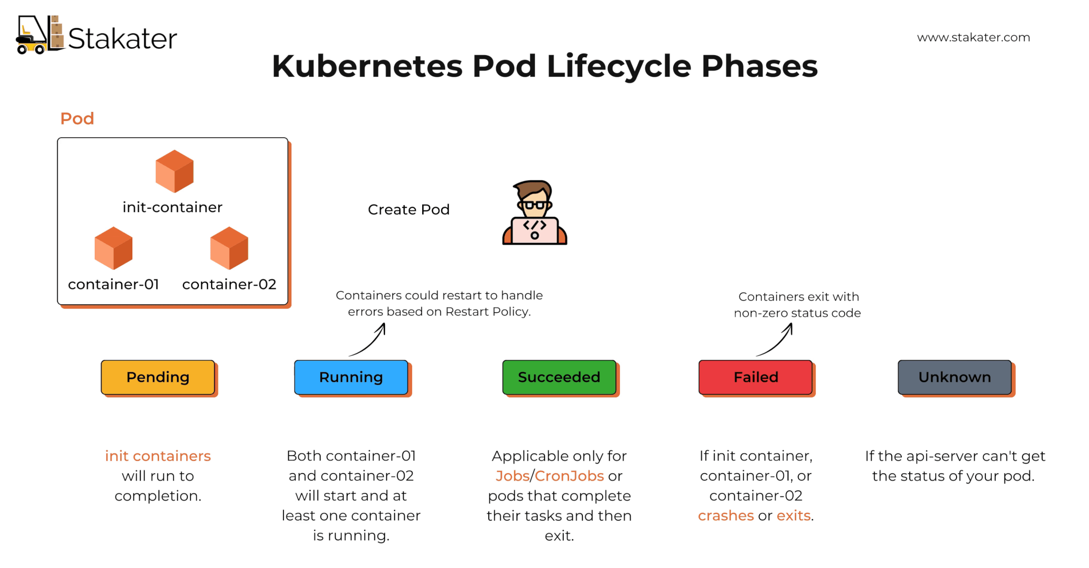
Pod phase
It watches for newly created Pods that don’t have a Node assigned yet, then selects a suitable Node for them
:

Slide 175
pod condition
It watches for newly created Pods that don’t have a Node assigned yet, then selects a suitable Node for them
Absolutely! Pod conditions are more detailed than Pod phases. While phases give a high-level lifecycle status (Pending, Running, Succeeded, Failed, Unknown), conditions describe specific aspects of a Pod’s state.
Condition | Meaning
Ready | True if the Pod is ready to serve traffic.
Initialized | True if all init containers have completed successfully.
ContainersReady | True if all main containers in the Pod are ready.
PodScheduled | True if the Pod has been scheduled to a node.
:

Slide 176
pod health check
It watches for newly created Pods that don’t have a Node assigned yet, then selects a suitable Node for them
1️⃣ Liveness ProbeChecks if the container is alive.If it fails, Kubernetes restarts the container.Useful for detecting situations like deadlocks or processes stuck inside the container.
Example: HTTP liveness probelivenessProbe: httpGet: path: /healthz port: 8080 initialDelaySeconds: 10 periodSeconds: 5initialDelaySeconds: wait before starting the first check.periodSeconds: how often to check.
2️⃣ Readiness ProbeChecks if the container is ready to serve traffic.If it fails, Kubernetes removes the Pod from service endpoints, so it stops receiving requests.The container is not restarted automatically.
Example: TCP readiness probereadinessProbe: tcpSocket: port: 3306
initialDelaySeconds: 5 periodSeconds: 10
:

Slide 177
pod health check
It watches for newly created Pods that don’t have a Node assigned yet, then selects a suitable Node for them
apiVersion: v1
kind: Pod
metadata:
name: nginx-liveness
spec:
containers:
- name: nginx
image: nginx:latest
ports:
- containerPort: 80
livenessProbe:
httpGet:
path: /ali # 👈 custom path
port: 80
initialDelaySeconds: 10 # wait before first probe
periodSeconds: 5 # check every 5 seconds
:

Slide 178
pod resource management
It watches for newly created Pods that don’t have a Node assigned yet, then selects a suitable Node for them
Each container inside a Pod can declare two main things:
1️⃣ RequestsThe minimum resources the container needs.Kubernetes uses requests during scheduling to decide which node has enough resources for the Pod.Example: cpu: 500m = 0.5 of a CPU core, memory: 256Mi = 256 MB RAM.If a node doesn’t have enough requested resources, the Pod won’t be scheduled there.
2️⃣ LimitsThe maximum resources the container can use.If the container tries to use more:CPU → throttled (slowed down, not killed).Memory → OOMKilled (terminated due to out-of-memory).
:

Slide 179
pod resource management
It watches for newly created Pods that don’t have a Node assigned yet, then selects a suitable Node for them
apiVersion: v1
kind: Pod
metadata:
name: resource-demo
spec:
containers:
- name: app
image: nginx
resources:
requests:
memory: "256Mi"
cpu: "500m"
limits:
memory: "512Mi"
cpu: "1"
:

Slide 180
Annotation
It watches for newly created Pods that don’t have a Node assigned yet, then selects a suitable Node for them
What are Annotations in Kubernetes?
Annotations are key-value pairs attached to Kubernetes objects (Pods, Services, Deployments, etc.).Unlike labels:Labels are used for selection (selectors, queries, grouping).Annotations are for storing non-identifying metadata (info, config, tooling).They don’t affect how Kubernetes schedules or groups objects.
apiVersion: v1
kind: Pod
metadata:
name: nginx-annotated
annotations:
description: "This pod runs nginx"
owner: "iman"
backup/schedule: "daily"
spec:
containers:
- name: nginx
image: nginx:latest
:

Slide 181
Node affinity
It watches for newly created Pods that don’t have a Node assigned yet, then selects a suitable Node for them
What is Node Affinity?
Node Affinity:
a way to control which nodes your Pod can be scheduled on, based on labels applied to nodes.It’s like nodeSelector but more powerful and flexible:Supports required (must match) and preferred (soft rule).
Supports operators (In, NotIn, Exists, etc.).
Types of Node Affinity
1-requiredDuringSchedulingIgnoredDuringExecution
Hard rule: Pod must run only on nodes that match.If no node matches → Pod stays Pending.
2-preferredDuringSchedulingIgnoredDuringExecution
Soft rule: Scheduler tries to place Pod on preferred nodes, but if not possible → it runs elsewhere.
⚠️ Both are IgnoredDuringExecution → means if labels change after Pod is running, Pod is not evicted
:

Slide 182
Node affinity
It watches for newly created Pods that don’t have a Node assigned yet, then selects a suitable Node for them
kubectl label node worker1 disktype=ssd
apiVersion: v1
kind: Pod
metadata:
name: nginx-hard-affinity
spec:
affinity:
nodeAffinity:
requiredDuringSchedulingIgnoredDuringExecution:
nodeSelectorTerms:
- matchExpressions:
- key: disktype
operator: In
values:
- ssd
containers:
- name: nginx
image: nginx
:

Slide 183
Node affinity
It watches for newly created Pods that don’t have a Node assigned yet, then selects a suitable Node for them
apiVersion: v1
kind: Pod
metadata:
name: nginx-soft-affinity
spec:
affinity:
nodeAffinity:
preferredDuringSchedulingIgnoredDuringExecution:
- weight: 1
preference:
matchExpressions:
- key: zone
operator: In
values:
- east
containers:
- name: nginx
image: nginx
:

Slide 184
Deployment
It watches for newly created Pods that don’t have a Node assigned yet, then selects a suitable Node for them
apiVersion: apps/v1 # Use the stable API version for Deployment resources
kind: Deployment # This resource is a Deployment (manages ReplicaSets and Pods)
metadata:
name: myapp-deployment # Name of the Deployment object
spec:
replicas: 3 # Run 3 copies (replicas) of the pod for high availability
selector:
matchLabels:
app: myapp # Select pods with label 'app: myapp' — these belong to this Deployment
template: # Pod template: defines the pods the Deployment will create
metadata:
labels:
app: myapp # Assign label 'app: myapp' to each pod for selection and grouping
spec:
containers: # List of containers to run inside each pod
- name: myapp # Name of the container (useful if there are multiple containers)
image: yourdockerhubusername/yourapp:latest # Docker image to run inside container
ports:
- containerPort: 3000 # Port exposed by the container (app listens here)
:

Slide 185
Deployment
It watches for newly created Pods that don’t have a Node assigned yet, then selects a suitable Node for them
matchLables vs lables?
The Deployment creates Pods using the template, which gives them the app: myapp label.The Deployment uses the selector to find all Pods with the label app: myapp.This way, the Deployment knows which Pods belong to it and can manage scaling, rolling updates, etc
matchLabels means: "Which Pods should I manage/control?“
labels means: "When I create a Pod, these are the labels I put on it."
:

Slide 186
Deployment
It watches for newly created Pods that don’t have a Node assigned yet, then selects a suitable Node for them
matchLables vs lables?
The Deployment creates Pods using the template, which gives them the app: myapp label.The Deployment uses the selector to find all Pods with the label app: myapp.This way, the Deployment knows which Pods belong to it and can manage scaling, rolling updates, etc
matchLabels means: "Which Pods should I manage/control?“
labels means: "When I create a Pod, these are the labels I put on it."
:

Slide 187
DaemonSet
It watches for newly created Pods that don’t have a Node assigned yet, then selects a suitable Node for them
In Kubernetes, a DaemonSet is a type of workload controller that ensures a copy of a Pod runs on every (or some) node in the cluster.
Key Points about DaemonSet:
Purpose: Deploy Pods that need to run on all nodes (or a selected group of nodes).
Examples:Logging agents (e.g., Fluentd, Filebeat).Monitoring agents (e.g., Prometheus Node Exporter, Datadog Agent).
Networking components (e.g., CNI plugins like Calico or Cilium).
Behavior:When a new node is added → DaemonSet automatically starts a Pod on it.
When a node is removed → The DaemonSet Pod is also removed.
:

Slide 188
DaemonSet
It watches for newly created Pods that don’t have a Node assigned yet, then selects a suitable Node for them
apiVersion: apps/v1 # Use the stable API version for DaemonSet resources
kind: DaemonSet # This resource is a DaemonSet (runs one pod on each node)
metadata:
name: my-daemonset # Name of the DaemonSet object
spec:
selector:
matchLabels:
name: my-daemon-pod # Selector to match pods managed by this DaemonSet
template:
metadata:
labels:
name: my-daemon-pod # Labels assigned to pods created by this DaemonSet
spec:
containers:
- name: daemon-container # Name of the container inside the pod
image: busybox # Container image (example: lightweight Linux image)
command: ["sleep", "3600"] # Command to keep the container running (sleep for 1 hour)
:

Slide 189
Service
It watches for newly created Pods that don’t have a Node assigned yet, then selects a suitable Node for them
apiVersion: v1 # API version for Service resources
kind: Service # This resource is a Service (exposes pods internally or externally)
metadata:
name: myapp-service # Name of the Service object
spec:
selector:
app: myapp # Select pods with label 'app: myapp' to send traffic to
ports:
- protocol: TCP # Protocol used by the Service (usually TCP)
port: 80 # Port exposed by the Service inside the cluster
targetPort: 3000 # Port on the pods that the Service forwards traffic to
type: ClusterIP or NodePort
:

Slide 190
endpoint
It watches for newly created Pods that don’t have a Node assigned yet, then selects a suitable Node for them
An Endpoints resource in Kubernetes is a list of IP addresses (and ports) that correspond to the pods backing a Service.
Kubectl get ep
:

Slide 191
Service Account
It watches for newly created Pods that don’t have a Node assigned yet, then selects a suitable Node for them
What is a Service Account?
A Service Account is an identity for processes that run inside Kubernetes pods.Unlike a user account (which is for people), a service account is used by applications and services running inside pods to interact with the Kubernetes API.It provides authentication and authorization so your application can securely communicate with the Kubernetes cluster.
Why do you need a Service Account?
To give your pods permissions to perform actions in the cluster, like reading secrets, listing pods, or creating resources.
Pods use service accounts to get access tokens that let them call the Kubernetes API safely.
If you don’t specify a service account, pods use the default service account in their namespace.
:

Slide 192
RBAC
It watches for newly created Pods that don’t have a Node assigned yet, then selects a suitable Node for them
What is RBAC?
RBAC stands for Role-Based Access Control.It’s a system Kubernetes uses to control who can do what inside the cluster.
How does RBAC work in Kubernetes?
It controls permissions by defining Roles (what actions are allowed) and RoleBindings (who gets those permissions).
RBAC lets you assign specific permissions to users, groups, or service accounts based on their roles.
This makes your cluster more secure by limiting access only to what’s necessary.
:

Slide 193
RBAC
It watches for newly created Pods that don’t have a Node assigned yet, then selects a suitable Node for them
What is RBAC?
RBAC stands for Role-Based Access Control.It’s a system Kubernetes uses to control who can do what inside the cluster.
How does RBAC work in Kubernetes?
It controls permissions by defining Roles (what actions are allowed) and RoleBindings (who gets those permissions).
RBAC lets you assign specific permissions to users, groups, or service accounts based on their roles.
This makes your cluster more secure by limiting access only to what’s necessary.
:

Slide 194
RBAC
It watches for newly created Pods that don’t have a Node assigned yet, then selects a suitable Node for them
Why use RBAC?
To follow the principle of least privilege:
give only necessary permissions.
To secure your cluster by preventing unauthorized access.
To manage permissions easily by grouping and assigning roles.
:

Slide 195
Role Binding
It watches for newly created Pods that don’t have a Node assigned yet, then selects a suitable Node for them
What is a RoleBinding in Kubernetes?
A RoleBinding is a Kubernetes object that assigns permissions defined in a Role to a user, group, or ServiceAccount within a specific namespace.
| Resource | Purpose |
| --------------- | ----------------------------------------------------- |
| **Role** | Defines permissions (verbs on resources) |
| **RoleBinding** | Assigns those permissions to users/groups/SvcAccounts |
:

Slide 196
Sample
It watches for newly created Pods that don’t have a Node assigned yet, then selects a suitable Node for them
# ServiceAccount definition
apiVersion: v1
kind: ServiceAccount
metadata:
name: example-sa
namespace: default
---
# Role definition: allows read access to pods
apiVersion: rbac.authorization.k8s.io/v1
kind: Role
metadata:
namespace: default
name: pod-reader
rules:
- apiGroups: [""]
resources: ["pods"]
verbs: ["get", "list", "watch"]
---
# RoleBinding: bind pod-reader Role to example-sa ServiceAccount
apiVersion: rbac.authorization.k8s.io/v1
kind: RoleBinding
metadata:
name: read-pods-binding
namespace: default
subjects:
- kind: ServiceAccount
name: example-sa
namespace: default
roleRef:
kind: Role
name: pod-reader
apiGroup: rbac.authorization.k8s.io
:

Slide 197
Service account with rolebinding
It watches for newly created Pods that don’t have a Node assigned yet, then selects a suitable Node for them
Why both need?
ServiceAccount is who you are.
RoleBinding is what you’re allowed to do.
Without RoleBinding, the ServiceAccount has no permissions.
Without ServiceAccount, no identity to assign permissions to.
:

Slide 198
Secret
It watches for newly created Pods that don’t have a Node assigned yet, then selects a suitable Node for them
What is a Secret in Kubernetes?
In Kubernetes, a Secret is an object used to store sensitive data like passwords, OAuth tokens, SSH keys, and other types of confidential information. Secrets are encoded in base64 format to prevent them from being exposed in plain text but can still be decoded by Kubernetes when needed.
Use Cases for Secrets:
Database credentials: Store usernames and passwords securely.
API keys: Store external API keys for your app.
TLS certificates: Store TLS private keys and certificates.
SSH keys: Store SSH keys for connecting to remote servers
:

Slide 199
Secret
It watches for newly created Pods that don’t have a Node assigned yet, then selects a suitable Node for them
Type | Use Case
Opaque | Generic secret for any sensitive data (default)
dockerconfigjson | Docker registry credentials (for private registries)
service-account-token | Service account tokens for Pods to authenticate with the API server
ssh-auth | SSH keys for authentication with remote systems
tls | TLS certificates and private keys for secure communication
:

Slide 200
PV and PVC
It watches for newly created Pods that don’t have a Node assigned yet, then selects a suitable Node for them
In Kubernetes, Persistent Volumes (PV) and Persistent Volume Claims (PVC) are used for managing storage resources in a cluster. These are part of the Kubernetes Storage API that allows you to provision and manage storage that is persistent across pod restarts
Persistent Volume (PV)A Persistent Volume (PV) is a storage resource in your Kubernetes cluster that exists independently of pods. PVs are pieces of storage that are provisioned by an administrator or dynamically provisioned using storage classes.Persistent means that the data is stored outside the lifecycle of a Pod, so even if the Pod dies or gets recreated, the data remains intact.PVs can be backed by different types of storage backends, such as local disk, NFS, cloud storage (like AWS EBS),Ceph storage and …..
:

Slide 201
PV and PVC
It watches for newly created Pods that don’t have a Node assigned yet, then selects a suitable Node for them
apiVersion: v1
kind: PersistentVolume
metadata:
name: my-pv
spec:
capacity:
storage: 10Gi # Amount of storage the PV provides
volumeMode: Filesystem # Filesystem mode, can be 'Block' as well
accessModes:
- ReadWriteOnce # Can be mounted as read-write by a single node
persistentVolumeReclaimPolicy: Retain # What happens when the PVC is deleted (Retain, Recycle, Delete)
storageClassName: nfs or ceph
# A reference to a StorageClass, which defines how the PV is provisioned
hostPath:
path: /mnt/data # A directory on the node's filesystem (for local PVs)
:

Slide 202
PV and PVC
It watches for newly created Pods that don’t have a Node assigned yet, then selects a suitable Node for them
Persistent Volume Claim (PVC)A Persistent Volume Claim (PVC) is a request for storage by a user or a pod. A PVC specifies how much storage is needed and what kind of access mode is required. Kubernetes then binds the PVC to a matching Persistent Volume (PV) based on available resources.
The user or application specifies their storage requirements (e.g., size, access mode) through a PVC, and Kubernetes ensures that the right PV gets bound to that PVC.
PVC abstracts the underlying storage so users don’t need to know about specific storage backends.
:

Slide 203
PV and PVC
apiVersion: v1
kind: PersistentVolumeClaim
metadata:
name: my-pvc
spec:
accessModes:
- ReadWriteOnce # Must match PV's access mode
resources:
requests:
storage: 10Gi # Request for 10Gi of storage
storageClassName: nfs or ceph # Must match PV's storage class if set
:

Slide 204
PV and PVC
How PV and PVC Work Together
1-PVCs request storage from available PVs based on their size and access mode.
2-The Kubernetes Scheduler matches the PVC to a PV (which meets the requirements of the PVC).
3-Once a match is found, the PVC binds to the PV.
4-Pods can then mount the PVC, giving them access to the persistent storage.
Access Modes of PVsAccess modes define how the volume can be mounted and used. Common access modes are:
ReadWriteOnce: The volume can be mounted as read-write by only one node at a time.
ReadOnlyMany: The volume can be mounted as read-only by many nodes.
ReadWriteMany: The volume can be mounted as read-write by many nodes.
:

Slide 205
PV and PVC
Persistent Volume Reclaim PoliciesThis defines what happens to the PV when the PVC is deleted. Common policies are:
Retain: The volume is not deleted and must be manually cleaned or reused.
Recycle: The volume is recycled, i.e., data is deleted, and it’s made available for reuse (this policy is deprecated).
Delete: The volume is deleted, and any associated data is also erased
:

Slide 206
Configmap
A ConfigMap is a Kubernetes object used to store non-secret configuration data in key-value pairs and make it available to your applications inside the cluster.Think of it like a shared config file managed by Kubernetes — so you don’t have to hard-code values inside your Docker image.
Stores plain text config (not passwords — use Secrets for that).
Can be consumed by pods as:
Environment variables
Files (mounted as a volume)
Command-line arguments.
Lets you change configuration without rebuilding the image.
:

Slide 207
Configmap
apiVersion: v1
kind: ConfigMap
metadata:
name: my-app-config
data:
APP_ENV: "production"
APP_PORT: "3000“
:

Slide 208
Rollout vs Rollback
A rollout is when Kubernetes updates your application to a new version.
This happens when you:
Change a Deployment (e.g., update container image tag).
Apply a new YAML manifest.
Scale your application up or down.
In Kubernetes, you can check rollout status with:
kubectl rollout status deployment my-app
kubectl rollout restart deployment my-app
:

Slide 209
Rollout vs Rollback
A rollback is when you undo the last rollout and go back to the previous working version.You use rollback when:
The new version is broken.
Config change caused downtime.
You want to quickly restore the last stable state
kubectl rollout undo deployment my-app
kubectl rollout undo deployment my-app --to-revision=3
Rollout = move forward 🚀
Rollback = go back ⏪
:
Action | What It Does | When You Use It
Rollout | Applies a new change (image, config, scaling) and gradually replaces old pods. | Deploying a new version of your app.
Rollback | Reverts a previous rollout and restores the old version/config. | When the new rollout fails or causes issues.

Slide 210
Update Strategies in Kubernetes
1️⃣ RollingUpdate (Default)
This is the most common strategy.It gradually replaces Pods one by one (or a few at a time) with new ones.This avoids downtime, because some old Pods stay running until the new Pods are ready
apiVersion: apps/v1
kind: Deployment
metadata:
name: my-app
spec:
replicas: 4
strategy:
type: RollingUpdate
rollingUpdate:
maxUnavailable: 1 # at most 1 pod down during update
maxSurge: 1 # at most 1 extra pod above desired count
template:
spec:
containers:
- name: my-app
image: my-image:v2
:

Slide 211
Update Strategies in Kubernetes
maxUnavailable: 1 → Never have more than 1 pod unavailable during rollout.maxSurge: 1 → Can temporarily create 1 extra pod to speed up rollout.
This means: while upgrading 4 pods, Kubernetes may briefly have 5 pods running until the old ones are removed.
✅ Best for: Most production apps (safe, no downtime if app is healthy).
2️⃣ Recreate
This strategy stops all old Pods first, then starts the new Pods.This causes downtime but ensures only one version runs at a time.
apiVersion: apps/v1
kind: Deployment
metadata:
name: my-app
spec:
replicas: 4
strategy:
type: Recreate
:

Slide 212

modern deployment strategies
Canary DeploymentGradually release a new version to a small percentage of users, monitor it, and then roll out to everyone if it looks good.
Deploy v2 to 5% of traffic, watch logs & metrics.
If no errors → increase to 50%.
Eventually → 100% traffic uses v2
✅ Pros:
Low risk — issues impact only a few users.
Easy rollback — just route all traffic back to v1.
❌ Cons:
Requires load balancing / routing logic
.More complex monitoring to detect failures.
:

Slide 213
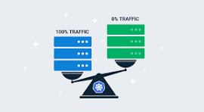
modern deployment strategies
🔵🟢 2) Blue-Green Deployment
Run two identical environments — Blue (current) and Green (new).
Once Green is fully ready, switch all traffic to Green at once.
Example Flow:Blue = live app (v1)Deploy v2 to Green environment, test it privately.If good → switch traffic from Blue → Green in one step.Blue becomes your rollback.
✅ Pros:
Zero downtime.I
nstant rollback (just switch back to Blue).
❌ Cons:
Doubles infrastructure cost during deployment.
Not good for slow, incremental rollout — it’s an all-or-nothing cutover.
:

Slide 214
modern deployment strategies
🔵🟢 2) Blue-Green Deployment
Run two identical environments — Blue (current) and Green (new).
Once Green is fully ready, switch all traffic to Green at once.
Example Flow:Blue = live app (v1)Deploy v2 to Green environment, test it privately.If good → switch traffic from Blue → Green in one step.Blue becomes your rollback.
✅ Pros:
Zero downtime.I
nstant rollback (just switch back to Blue).
❌ Cons:
Doubles infrastructure cost during deployment.
Not good for slow, incremental rollout — it’s an all-or-nothing cutover.
:

Slide 215
modern deployment strategies
🧪 3) A/B
TestingRoute traffic to different versions based on rules (not just percentages).
Example Flow:Send new users to v2.Keep existing users on v1.Or test different features in each version and compare metrics.
✅ Pros:
Great for product experiments (conversion testing).
You can test multiple variants simultaneously (v1, v2, v3…).
❌ Cons:
Requires feature flagging or routing logic.
More for product/UX validation than backend stability.
:

Slide 216
modern deployment strategies
4)service mesh
nstead of coding routing logic manually, you use a service mesh (like Istio, Linkerd, Consul)to control traffic splitting, retries, observability, security at the network layer.With a mesh, Canary, Blue-Green, and A/B become traffic rules, not app logic.
✅ Pros:
No changes to app code or CI/CD pipeline.
Powerful: traffic splitting, circuit breaking, observability.
Can do progressive delivery (automated canary with rollback on failure).
❌ Cons:
More complex to set up (control plane, sidecars).
Adds operational overhead if you don’t already have a mesh.
:

Slide 217
modern deployment strategies
5) shadow
Shadow (or traffic mirroring) means:You duplicate real production traffic to a new version of the app (v2), but users never see its responses.The mirrored traffic lets you test performance, correctness, and behavior under real load — without impacting real users.
Example:
v1 = live production app
v2 = shadow app100% of user requests go to v1 normally.
A copy of those requests is sent to v2.
v2 runs, logs, metrics are collected — but its response is discarded.
✅ Pros:
No risk for users — they never see errors from v2.
Test under real production load.
Great for performance tuning, schema validation, or checking backward compatibility.
❌ Cons:
Doubles traffic → can be expensive if high load.
Side effects (writes!) must be disabled — v2 must be safe to receive real data without breaking things.
Needs observability to compare results between v1 and v2.
:

Slide 218
modern deployment strategies
Strategy | Traffic Control | User Impact | Rollback Effort | Cost | Best Use
Canary | % of traffic to v2 | Users may see issues if v2 fails | Easy (route back to v1) | Normal | Safe incremental release
Blue-Green | All-or-nothing switch | Users see only one version | Instant (switch back) | High (double infra) | Zero-downtime switchovers
A/B Test | Segmented by user attributes | Users split intentionally | N/A (both live) | Higher | Product experiments, UX validation
Shadow | 100% traffic copied silently | No user impact | No rollback needed | High (duplicate traffic) | Load testing, pre-release validation
Service Mesh | Traffic policy engine | Depends on rules | Easy (change route weights) | Normal | Implements all above strategies with fine-grained control
:

